Slide 1
Unveiling AKI Subphenotypes: The Role of Artificial Intelligence and Beyond
Innovative Therapies for AKI: New Horizons
Sejoong Kim
Seoul National University Bundang Hospital
Seoul National University College of Medicine
December 5 (Friday), 2025
13:30-14:45 (15 minutes 13:45-14:00)
Room 4 (701 EF)
Notes:
Good afternoon everyone. Thank you for joining this session.
Today, I want to share a simple but powerful idea: AKI is not one disease. AI and biomarkers now allow us to see different patterns, different risks, and different mechanisms inside AKI. This talk will show how this new way of thinking can finally improve outcomes for our patients.”

Slide 2
Disclosures
Disclose relevant financial relationships:
• Research support: NRF, KHIDI, NECA, Korean Society of Nephrology • Advisory roles: AstraZeneca, Bayer, Vantive etc • Co-CEO, SickGPT Co.
• No financial relationships relevant to this presentation
Notes:
These are my disclosures. None of them are directly related to today’s scientific content, and nothing here will influence the messages I am going to share with you.”

Slide 3



Agenda & Learning Objectives
1
Why We Need a New Approach to AKI
4
Clinical Applications & Future
Limits of KDIGO criteria
EUPHRATES/Tigris clinical trials
Why AKI clinical trials keep failing
Enrichment trial design strategies
Heterogeneity and precision medicine
Multi-omics & precision nephrology
2
Using AI to Find AKI Subtypes
5
Conclusions & Key Takeaways
Unsupervised ML and clustering
Clinical value of subtype-based approach
Septic AKI: SP1/SP2 subtypes
Cardiac surgery AKI prediction
Learning Objectives
3
Combining Clinical Data & Biomarkers
Understand why AKI subtypes matter
AKI biomarker timeline
Learn how AI/ML helps in nephrology
Subclinical AKI & NephroCheck
See how biomarkers connect with data
Notes:
“Here is our plan for the next 15 minutes. First, why traditional AKI diagnosis has reached its limits. Second, how AI can reveal hidden subtypes that we could not see before. Third, how biomarkers help us understand the biology behind these subtypes. Fourth, how all of this connects to clinical trials and future treatments. And finally, the key messages you can apply immediately in practice.”

Slide 4



Why We Need a New Approach to AKI
1
Traditional AKI diagnosis has reached its limits
Data, AI, and precision medicine open a new path forward
Notes:
“For decades, we used creatinine and urine output to diagnose AKI. This was necessary, but it is no longer enough. It is time to move toward a new approach powered by data, AI, and precision medicine.”

Slide 5




Limitations of KDIGO Criteria
Late Indicator Problem
Serum creatinine and urine output measure kidney 'function', not actual kidney 'damage’.
They only change after significant injury has already happened, causing us to miss critical early treatment windows.
Missing Disease Mechanisms
Creatinine only rises
While KDIGO helped standardize diagnosis,
it doesn't capture the different causes or biological processes of kidney injury.
This puts fundamentally different disease processes into the same category.
Different AKI Types That KDIGO Misses
Why Treatments Fail
Inflammatory AKI (sepsis, COVID-19)
Ischemic AKI (cardiac surgery, shock)
By grouping biologically different patients together,
clinical trials often fail because treatments that might help specific subtypes show no benefit when tested in the entire mixed group.
Drug-induced kidney toxicity
Immune/autoimmune kidney injury
* KDIGO: Kidney Disease: Improving Global Outcomes
Notes:
“KDIGO was a major step forward, but it measures kidney function, not kidney damage. Creatinine rises only after significant injury. And KDIGO mixes very different mechanisms—sepsis, ischemia, toxins—into the same category.
This is why so many AKI trials fail: We test one drug in a mixed population with mixed biology. Any real benefit gets diluted.
We need to move beyond functional markers.”

Slide 6











CHAPTER 3
PHENOTYPE STRATEGY
AKI Phenotypes in Asia-Pacific: Match Drug to Biology
03
HIGH PREVALENCE
Sepsis-Associated AKI
Cardiac Surgery (CSA-AKI)
Nephrotoxins
Driven by inflammation, microvascular dysfunction, and metabolic reprogramming. Not just ischemia.
Predictable timing of insult. Allows for precise pre- and post-op risk stratification.
Direct tubular toxicity from agents like Cisplatin or Colistin. Common in oncology/ICU.
Target: IL-6 / Endotoxin
Target: TIMP-2*IGFBP7
Target: Urinary KIM-1
Contrast Exposure
Low Perfusion / Prerenal
Key Insight
Vasoconstriction & direct toxicity. Focus on prevention trials in high-risk angio patients.
Volume-responsive vs. persistent injury. Must stratify before randomization.
"Enrichment is impossible without understanding these distinct biological rows."
Target: Mehran Risk Score
Target: Fluid Response Test
Asia-Pacific AKI Phenotypes
Notes:
“In Asia-Pacific, we see several major AKI phenotypes—sepsis, cardiac surgery, nephrotoxins, contrast, and low perfusion. Each of these has a different biological pathway. And because the pathways are different, the treatments must be different.
The key message from this slide is strong: Enrichment is impossible unless we understand these biological rows.”

Slide 7
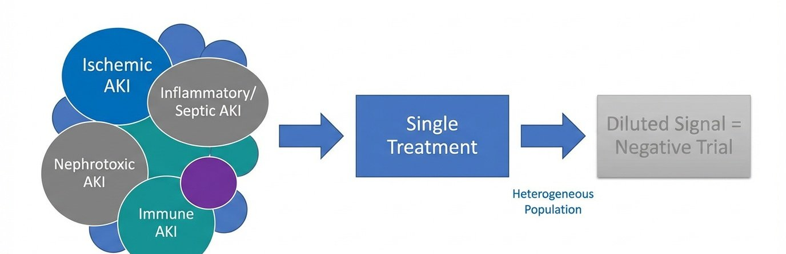
Why Clinical Trials Fail: Mixed Biology
APCN 2025 | Seoul, Korea
Visualizing "Diluted Signal"
The Core Issue
The Solution
Mixing biologically different patients dilutes efficacy.
Enrichment strategies targeting specific subphenotypes.
Unveiling AKI Subphenotypes: The Role of AI and Beyond
4
Notes:
“Here you can see the core issue with AKI trials. We mix ischemic AKI, inflammatory AKI, nephrotoxic AKI, and immune AKI—and then we test a single therapy. The biology becomes diluted, and the trial becomes negative.
The solution is simple and powerful: Target specific subphenotypes rather than mixing everyone together.”

Slide 8



Why Clinical Trials Fail
Patient Heterogeneity Problem
For decades, AKI clinical trials have failed mainly because patient groups are too different from each other.
When we group patients with different disease processes together, treatment effects that only work in specific subgroups get diluted.
ATHOS-3 Trial Example (Angiotensin II for the Treatment of High-Output Shock-3
Angiotensin II didn't improve survival rates in the entire shock patient group.
However, when researchers looked closer, they found it actually helped a specific subgroup of patients who had septic AKI.
ATHOS-3 Case Analysis
Masked Benefit Effect
Angiotensin II treatment didn't improve survival in the whole patient group (p=0.26). However, post-analysis showed survival benefits in the septic AKI subgroup, especially those with inflammatory endothelial damage (p=0.01).
This "hidden benefit" happens when a treatment shows no statistical benefit in the whole group,
but actually works well in specific subtypes.
This shows we need to completely change how we design clinical trials.
This highlights the importance of "enrichment" trial design - identifying patient groups most likely to benefit from a treatment before the trial begins.
* ATHOS-3: Angiotensin II for the Treatment of High-Output Shock
Notes:
ATHOS-3 is the perfect example of hidden benefit. The trial showed that giving angiotensin II could quickly raise blood pressure within minutes and reduce the need for other vasopressors. It did not clearly improve survival, But in a specific subgroup—septic AKI with endothelial injury—it worked dramatically well.
What looked like a negative trial was actually a positive trial in the right patients. This is why enrichment is essential for AKI clinical trials.”

Slide 9














CHAPTER 2
STRATEGIC SOLUTION
The Solution: Patient Enrichment (A → C → D)
02
Group A
Group C
Group D
Success
ESTABLISHED AKI
HIGH RISK
SPECIFIC RESPONDERS
CLINICAL TRIAL
"All-Comers"
Destined for adverse outcome
Matched to drug mechanism
High Signal-to-Noise Ratio Clear benefit demonstrated
High heterogeneity
Prognostic Enrichment
Diagnostic & Predictive
Risk Scores (RAI) + Biomarkers (TIMP-2*IGFBP7)
Mechanism Biomarkers + Biopsy (Tissue/Liquid)
Biologically Plausible
Target Present
Group B: Low Risk
Excluded to avoid dilution.
Managed with Standard Care.
Key Strategy: Don't just treat AKI. Treat the specific responder mechanism.
Biomarkers
Genomics
Biopsy
Asia-Pacific AKI Report 2024
Notes:
“Here is the strategic solution to the AKI heterogeneity problem. Group A represents all-comer AKI—too mixed, too noisy, impossible to treat as a single group. Group C identifies the high-risk patients using prognostic and diagnostic biomarkers. But the key is Group D: the specific responders who match the drug’s biological mechanism.
When we enrich from A to C to D, the treatment signal becomes strong instead of diluted. So the message is clear: Don’t just treat AKI. Treat the responder mechanism.”

Slide 10
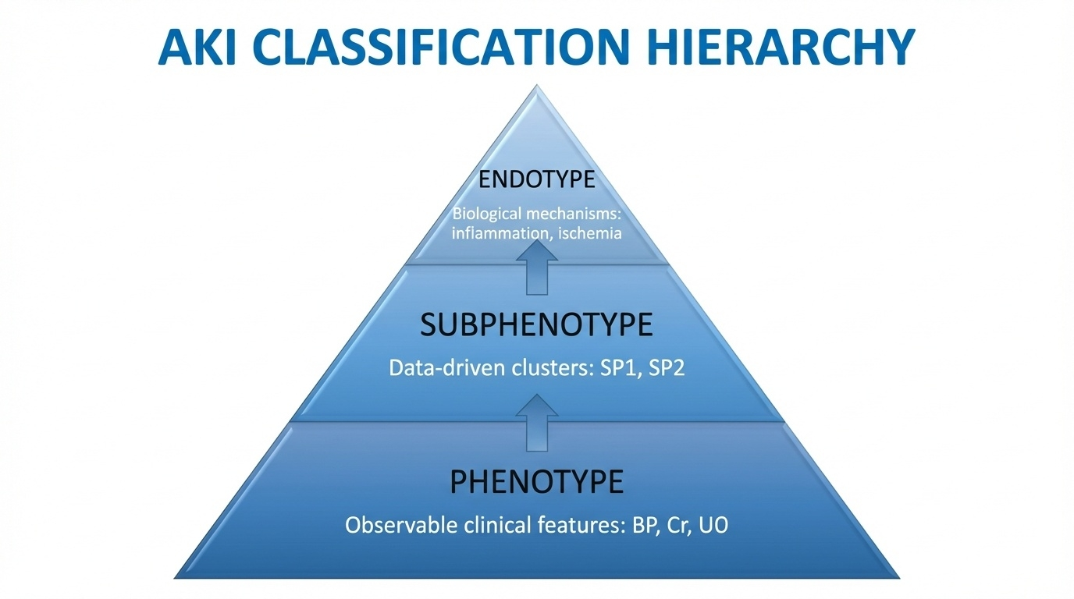






From Phenotype to Endotype
APCN 2025 | Seoul, Korea
3. Endotype
Biological Mechanism
Specific molecular pathways (e.g., inflammation, ischemia) driving the disease process.
2. Subphenotype
Data-Driven Clusters
Groups with shared characteristics identified by AI/ML (e.g., SP1 vs SP2).
1. Clinical Phenotype
Observable Features
What we see at bedside: BP, Urine Output, Creatinine, Comorbidities.
Layered Classification Model
Why This Matters: Precision Nephrology Applications
Patient Selection
Enriched Trials
Targeted Therapy
Identify high-risk groups who need intensive monitoring.
Design trials for specific biological subgroups (Predictive Enrichment).
Deliver mechanism-specific treatments (e.g., anti-inflammatory for SP2).
Unveiling AKI Subphenotypes: The Role of AI and Beyond
5
Notes:
This layered pyramid shows our journey toward precision nephrology. Phenotypes are what we see at the bedside—blood pressure, urine output, creatinine. Subphenotypes come from AI and data-driven clustering—groups like SP1 and SP2. Endotypes reveal the biological mechanism, such as inflammation or ischemia.
Only when we reach the endotype level can we develop treatments that truly match the disease. This is how we transform AKI management from reactive care to precise, mechanism-guided therapy.”

Slide 11

Using AI to Find AKI Subtypes
2
How big data & machine learning reveal hidden AKI patterns
Unsupervised learning, clustering, and real-world examples
Notes:
“Now let’s explore how AI helps us discover AKI subtypes that humans cannot see. AI brings structure to the complexity of ICU data and reveals hidden groups with different risks and different outcomes.”

Slide 12
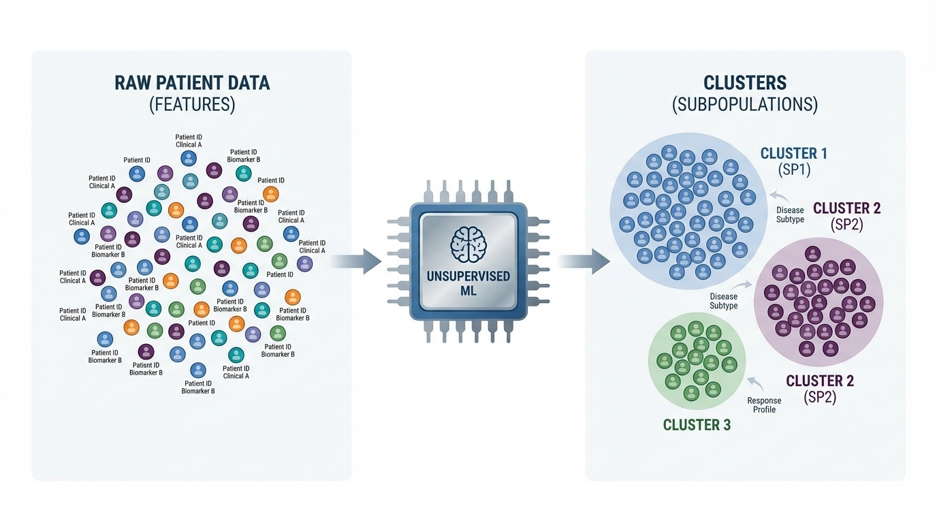



AI for Subtype Discovery
APCN 2025 | Seoul, Korea
CORE METHODS
K-means Clustering
Hierarchical Clustering
Deep Embedded Clustering
BIG DATA FOUNDATION
PRIMARY DATASETS
MIMIC-IV & eICU-CRD
KOREAN DATASETS
Unsupervised Machine Learning: Finding Hidden Patterns
SNUH & SNUBH CDM Data
From Chaos to Structure: Reproducible Subphenotypes
1
Hypothesis-Free
2
Multidimensional
3
Clinically Distinct
Discovers patterns without human bias or pre-conceived definitions.
Integrates vitals, labs, and medications simultaneously.
Clusters show significantly different outcomes and treatment responses.
Unveiling AKI Subphenotypes: The Role of AI and Beyond
6
Notes:
Unsupervised learning is a powerful tool because it doesn’t rely on human assumptions. Methods like K-means, hierarchical clustering, and deep embedded clustering analyze hundreds of variables at once—vitals, labs, medications, comorbidities.
What emerges are clinically distinct clusters with different mortality, different dialysis needs, and different treatment responses. AI allows us to discover patterns that traditional statistics simply cannot capture.”

Slide 13



Unsupervised Machine Learning in Clinical Data
Big Data for Finding Subtypes
Large ICU databases like MIMIC-IV and eICU-CRD are the foundation for AKI subtype research.
These public datasets contain hundreds of variables and thousands of patient records.
How Unsupervised Learning Works
This machine learning approach finds patterns in data without any prior hypothesis.
Algorithms like K-means, hierarchical clustering, and deep clustering automatically group patients with similar characteristics.
Recent Research Findings
Data-Driven Discovery
Zhang et al. (2024): Discovered 7 distinct AKI subtypes using deep clustering on MIMIC-IV and eICU-CRD data
The system analyzes hundreds of clinical variables (test results, vital signs, medications, conditions) to find hidden relationships. This reveals complex patterns that traditional statistics would miss.
Bhatraju et al. (2019): Identified SP1/SP2 subtypes in septic AKI with different treatment responses
Chaudhary et al. (2020): Found 3 AKI subtypes with different outcomes
* MIMIC-IV: Medical Information Mart for Intensive Care; eICU-CRD: eICU Collaborative Research Database
Notes:
Large ICU databases like MIMIC-IV and eICU give us the scale needed to find meaningful AKI subtypes. Unsupervised learning analyzes hundreds of features per patient and uncovers relationships we would never detect manually.
Recent studies consistently show reproducible subtypes. Across populations and methods, the message is the same: AKI is not one disease—and the data prove it.”

Slide 14


Septic AKI: SP1 & SP2 Subtypes
Discovery of Subtypes
SP2 patients actually do worse with liberal fluid therapy. This is clear evidence that we need subtype-specific treatments.
Septic AKI patients fall into two distinct groups:
Characteristic
SP1 (Low-risk)
SP2 (High Inflammation)
Severity Score
Low
High
Molecular Differences
Organ Function
Good
Multiple Organ Failure
SP2 patients show high levels of inflammation markers like sTNFR-1 and suPAR, need more blood pressure medications, and have proteins in urine showing immune system overactivation (TNFRSF11B, CXCL1).
This helps us understand why they get sicker.
Key Biomarkers
Normal/Mild Elevation
sTNFR-1↑, IL-6↑, suPAR↑
28-day Mortality
~15%
~45%
Vasopressor Need
Low
High
Treatment Response Differences
The key finding: these groups respond differently to the same treatment.
SP2 patients actually had higher death rates with liberal fluid therapy,
while SP1 patients weren't affected by fluid strategy.
This shows why personalized treatment is so important.
Clinical Impact
Patient selection based on subtypes is crucial for clinical trials to avoid diluting treatment effects. SP2 patients could especially benefit from anti-inflammatory treatments or endothelial protection therapies.
Critical Care (2020) 24:150
Notes:
In septic AKI of this study, two clear subtypes appear. SP1 is a lower-risk group with better organ function. SP2 is highly inflammatory, with markers like sTNFR-1, suPAR, and IL-6 sharply elevated.
The clinical impact is massive: SP2 patients had worse outcomes with liberal fluid therapy, while SP1 patients did not. Same treatment, opposite results—depending entirely on subtype. This is direct evidence that AKI requires subtype-specific therapy.”

Slide 15




Utilization of Deep Learning for Subphenotype Identification in Sepsis-Associated AKI
MIMIC-IV Database Analysis
TOTAL COHORT SIZE
Data Acquisition
N = 4,001
Utilized Electronic Health Records (EHR) from tertiary care ICUs. Includes routinely collected vital signs, laboratory values, and comorbidity data.
Sepsis-Associated AKI Patients
Patient Selection
Adult patients with Sepsis and Acute Kidney Injury (AKI). Focused on early identification within 48 hours of ICU admission.
Subphenotype 1
n=1,443 (36.1%)
Deep Learning Modeling
Subphenotype 2
n=1,898 (47.4%)
Utilized Deep Autoencoder to extract latent features from high-dimensional clinical data, capturing complex non-linear relationships.
Subphenotype 3
n=660 (16.5%)
Clustering Analysis
Performed K-Means Clustering based on extracted features to determine optimal subphenotypes and assign patients to distinct groups.
* Exclusions: Age <18, admission <24h, or End-Stage Renal Disease (ESRD)
Methods
Page 02
Notes:
Here is another study. In this analysis of 4,001 sepsis-associated AKI patients, a deep autoencoder extracted latent features from routine clinical data—simply vitals, labs, and comorbidities. Clustering these latent features revealed three clear subphenotypes.
What’s important is that we did not need genomics or proteomics to find them. Deep learning showed that powerful biological grouping can come from everyday clinical data.”

Slide 16


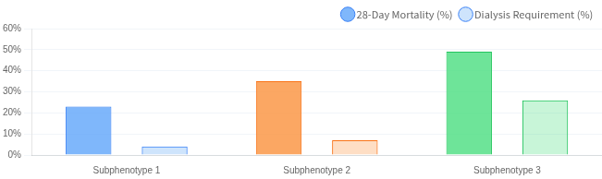
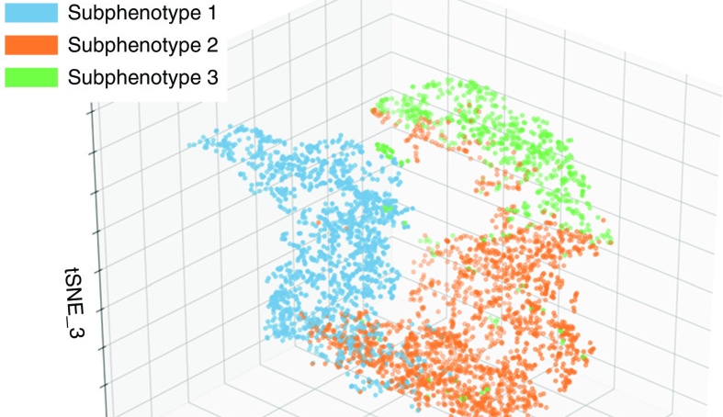

KEY OUTCOMES & VISUALIZATION
Key Outcomes: Mortality, Dialysis & Clustering
Sub 1
Sub 2
Sub 3
t-SNE Clustering
3 distinct clusters
Clinical Outcomes (28-Day Mortality & Dialysis)
SUBPHENOTYPE
28-DAY MORTALITY
DIALYSIS REQ.
RISK PROFILE
Sub 1
23% Reference
4% Reference
Baseline
Sub 2
35% aOR 1.4 (1.2-1.6)
7% Not Signif.
Moderate Risk
Sub 3
49% aOR 1.9 (1.5-2.4)
26% aOR 3.6 (2.5-5.4)
High Risk
Insight: The three subphenotypes form distinct clusters, indicating clear differences in clinical characteristics.
KEY FINDING
Using deep learning and clustering, we successfully identified three distinct SA-AKI subphenotypes with differing prognoses using only routinely collected clinical data.
Results & Analysis
* aOR: Adjusted Odds Ratio
* CI: Confidence Interval
|
Page 03
Notes:
The three subphenotypes formed distinct clusters, and their clinical outcomes were dramatically different. Subtype 1 had the lowest mortality. Subtype 2 showed moderate risk. Subtype 3 had almost 50% mortality and a dialysis rate above 25%.
This means AI-derived subtypes are not abstract—they are clinically meaningful and can guide triage, resource use, and trial selection.”

Slide 17






RESEARCH OVERVIEW
BASED ON RESEARCH
Precision Medicine in Sepsis:
JAMA 2019
Machine Learning-Derived Clinical Phenotypes
Seymour et al.
Identifying distinct clinical trajectories to overcome the limitations of traditional sepsis management.
The Clinical Challenge
Research Objective
Sepsis is a highly heterogeneous syndrome.
To identify clinically and biologically meaningful sepsis phenotypes.
Traditional diagnostic criteria pool dissimilar patients together, contributing to the repeated failure of "one-size-fits-all" clinical trials over the past 30 years.
Using data-driven approaches to classify patients into distinct subgroups, enabling the transition toward precision medicine and targeted therapies.
SENECA Project Methodology
47,712
29
AI
Key Takeaway
TOTAL PATIENTS
CLINICAL VARIABLES
MACHINE LEARNING
"One-size-fits-all" approaches are insufficient.
Derivation (16k) +
Demographics, Vitals,
Consensus k-means
Shift to Precision Care
Validation (31k)
Labs
Clustering
Derivation, Validation, and Potential Treatment Implications of Novel Clinical Phenotypes for Sepsis (JAMA. 2019;321(20):2003-2017)
Slide 1 of 3
Notes:
The same principles appear in sepsis research. In the JAMA 2019 study of nearly 48,000 patients, AI revealed four reproducible phenotypes—Alpha, Beta, Gamma, and Delta. This was a landmark demonstration that data-driven phenotypes are real and clinically powerful.
The message carries over directly to AKI: heterogeneous syndromes must be divided into meaningful biological groups.”

Slide 18
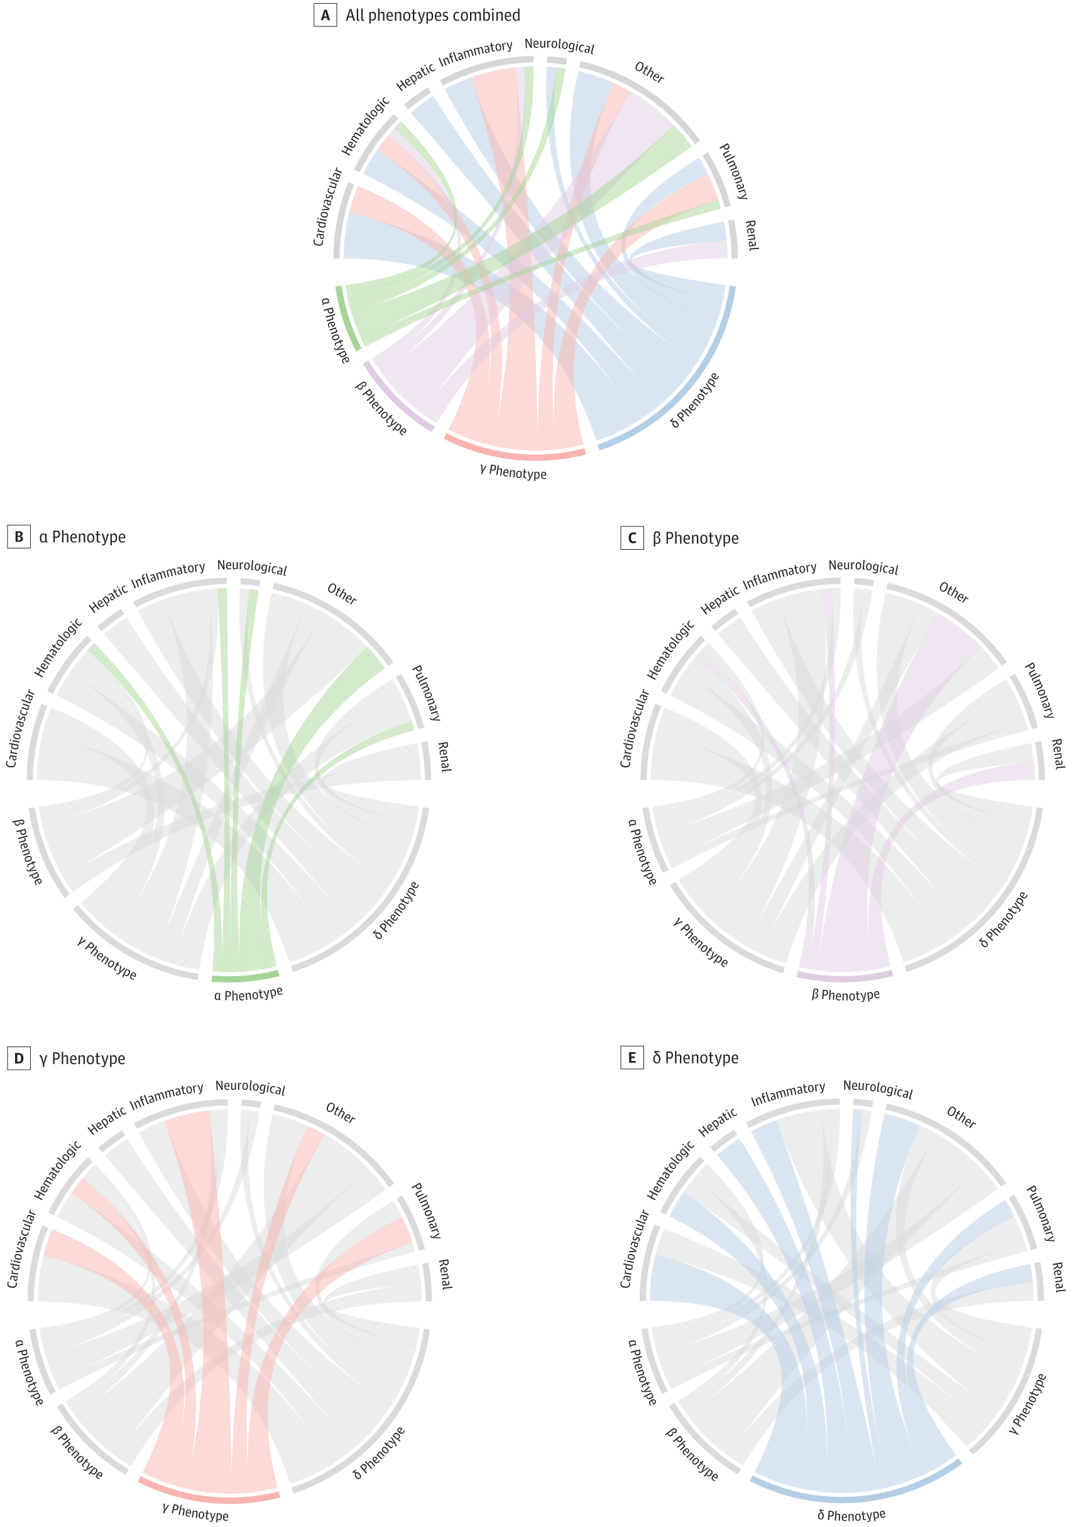
PHENOTYPE CLASSIFICATION
Four Sepsis Phenotypes (α, β, γ, δ)
SENECA Study
JAMA 2019
Distinct clinical trajectories, organ dysfunction patterns, and mortality risks
α
Mortality: 2%
β
Mortality: ~13%
γ
Mortality: ~24%
δ
Mortality: 40%
Alpha
Beta
Gamma
Delta
Host-Resilient
Older / Renal
Inflammatory
Shock / Hepatic
Prevalence: ~33%
Prevalence: ~27%
Prevalence: ~27%
Prevalence: ~13%
CLINICAL FEATURES
CLINICAL FEATURES
CLINICAL FEATURES
CLINICAL FEATURES
Low Risk: Most common, least severe presentation.
Comorbidity: Highest mean age and chronic illness burden.
Pulmonary: Respiratory dysfunction / pneumonia.
Critical: Most severe phenotype.
Profound shock requiring high vasopressors.
Stable: Lowest vasopressor requirement.
Renal dysfunction is the hallmark.
Fever and systemic inflammation.
Hepatic dysfunction & Coagulopathy.
Minimal organ dysfunction.
LABS & MARKERS
LABS & MARKERS
Elevated Creatinine.
High WBC, CRP, Ferritin.
LABS & MARKERS
LABS & MARKERS
Acute Kidney Injury (AKI) & Chronic Kidney Disease (CKD).
Hypoalbuminemia.
High Lactate & Bilirubin.
Abnormal markers are less prominent compared to others.
Cytokine storm (IL-6, IL-10, TNF).
Elevated Troponin.
Hemodynamically stable.
High INR / Low Platelets (DIC).
Seymour et al. Derivation, Validation, and Potential Treatment Implications of Novel Clinical Phenotypes for Sepsis. JAMA. 2019
Slide 2 of 3
Notes:
Here you can see the four phenotypes clearly. Alpha is stable and low-risk. Beta is older and renal-dominant. Gamma is inflammatory. Delta is shock with hepatic injury and the highest mortality.
Each phenotype has unique labs, organ patterns, and treatment implications. This framework directly supports our approach to AKI subtyping.”

Slide 19




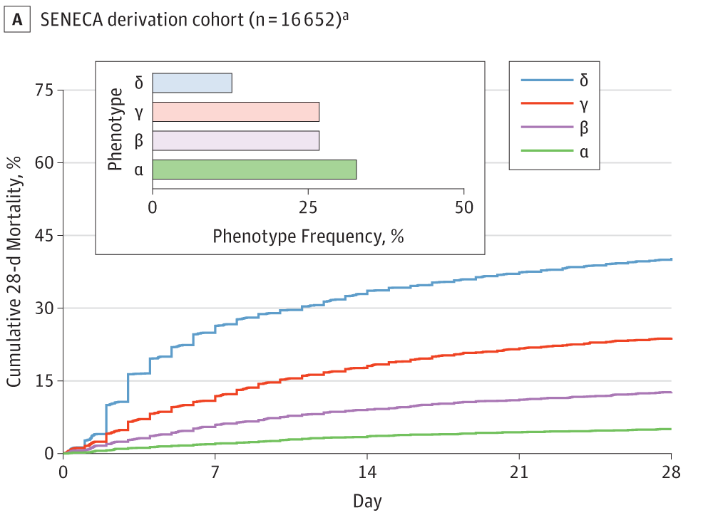





OUTCOMES & APPLICATION
SENECA Study
Clinical Findings & Therapeutic Implications
JAMA 2019
Mortality gradients and the shift towards phenotype-guided precision care
Mortality Gradient (28-Day)
Phenotype-Specific Therapeutic Implications
α
~2-5%
Delta (δ): Shock & Hepatic
β
~13%
Benefits from aggressive early resuscitation (EGDT) & fluids. Candidate for anticoagulation.
γ
~24%
δ
~40%
Gamma (γ) & Delta (δ): Inflammatory
Primary targets for immunomodulatory therapies due to high cytokine burden.
Key Finding: Delta (Red) shows rapid early decline
Alpha (α): Host-Resilient
Avoid overtreatment. Conservative management sufficient; excess fluids harmful.
Future Trial Design
Clinical Implementation
Predictive Enrichment: Match mechanism to phenotype.
Moving from research to bedside requires real-time integration.
Stratification: Randomize by phenotype to avoid dilution.
EHR Integration
Automated 29-variable classification
Kaplan-Meier survival estimates (JAMA 2019)
Seymour et al. Derivation, Validation, and Potential Treatment Implications of Novel Clinical Phenotypes for Sepsis. JAMA. 2019
Slide 3 of 3
Notes:
The mortality gradient across the four sepsis phenotypes is striking— Alpha around 2%, Beta around 13%, Gamma around 24%, and Delta near 40%. But the key insight is not just mortality. Each phenotype suggests a different therapeutic path. Delta may benefit from aggressive resuscitation and anticoagulation. Gamma and Delta have high cytokine levels, making them candidates for immunomodulatory therapies. Alpha patients, however, should avoid overtreatment. This is a powerful example of how phenotyping leads to personalized care.”

Slide 20

Biomarkers and Molecular Insights
3
Adding molecular details to AI-discovered subtypes
The power of combining biomarkers
Notes:
Now let’s look at how biomarkers help us move from data-driven subtypes to true biological endotypes. Biomarkers give meaning to what AI discovers.”

Slide 21




AKI Biomarker Timeline
Systemic Inflammation
Tubular Damage
Early injury triggers a surge of inflammatory markers like IL-6 and TNF-α.
Studies show that high IL-6 levels before cardiac surgery increase the risk of severe AKI by 6 times in pediatric patients.
NGAL, KIM-1, and L-FABP indicate actual kidney tubule damage.
At this stage, creatinine may still be normal - a condition called "subclinical AKI" that current criteria often miss.
Endothelial Dysfunction
Functional Decline
Inflammation leads to blood vessel lining damage, measured by suPAR and s-RAGE biomarkers. These markers are linked to worse outcomes and higher mortality in critically ill patients.
Only after significant nephron loss do we see rising serum creatinine levels. By this point, the golden window for effective treatment has often passed.
Biomarkers reflect the pathophysiological stages of AKI in sequence.
Damage markers rise long before functional markers (creatinine) show any change.
Cell Cycle Arrest
Subclinical AKI Concept
Kidney cells enter a protective state to prevent damaged DNA replication and save energy. TIMP-2 and IGFBP7 biomarkers detect this stage. The NephroCheck® test measures these to assess AKI risk.
When damage biomarkers are positive but creatinine remains normal, we call this "subclinical AKI." This provides a critical window for early intervention that would be completely missed using standard KDIGO criteria.
* Bhatraju et al. JASN 2019, Shao et al. Crit Care 2022, Fan et al. Kidney Med 2023
Notes:
This timeline shows the full journey of AKI biology. Inflammation begins first, followed by endothelial injury measured by markers like suPAR and sRAGE. Next comes cell-cycle arrest, captured by TIMP-2 and IGFBP7. Then tubular damage appears with NGAL or KIM-1. Finally—only after all of this—creatinine rises.
This means that creatinine is the last marker to change, long after intervention opportunities have passed. Early biomarkers reveal a silent phase where treatment is still possible.”

Slide 22


NephroCheck and Subclinical AKI
TIMP-2/IGFBP7 Biomarkers
NephroCheck® Test
Early markers that detect kidney tubular cell stress and cell cycle arrest. They reflect cellular damage before serum creatinine rises, enabling earlier diagnosis.
FDA-approved first biomarker test for AKI risk assessment, clinically validated to predict moderate-severe AKI risk within 12 hours.
Subclinical AKI Concept
Early kidney damage detected by biomarkers but without creatinine elevation. This addresses the "diagnostic blind spot" that traditional KDIGO criteria cannot identify.
NephroCheck (TIMP-2•IGFBP7) detects cellular damage long before creatinine rises, providing opportunity for preventive intervention.
Clinical Value
Clinical Validation Data
AUC (Diagnostic Accuracy):
0.82 (95% CI: 0.76-0.88)
Enables early intervention to reduce risk of progression to severe AKI. Helps identify high-risk patients, adjust nephrotoxic medications, and optimize hemodynamics proactively.
Sensitivity:
89%
Specificity:
81%
FDA Approval:
2014
Validated in:
Over 1,000 critically ill patients
* TIMP-2: Tissue Inhibitor of Metalloproteinases-2, IGFBP7: Insulin-like Growth Factor-Binding Protein 7
Notes:
NephroCheck measures TIMP-2 and IGFBP7, detecting cell stress long before structural injury becomes visible. This creates a new diagnostic category: subclinical AKI—biomarker-positive but creatinine-normal.
Identifying subclinical AKI allows us to adjust fluids, avoid nephrotoxins, and optimize hemodynamics before real damage occurs. This is the kind of early-warning system AKI has been missing for decades.”

Slide 23


Molecular Endotypes and Treatment Strategies
From Data-Driven Subtypes to Biological Endotypes
AI-discovered clinical subtypes become true biological endotypes only when validated with biomarkers.
This process transforms mathematical clusters into real biological entities with distinct mechanisms.
Role of Molecular Biomarker Panels
In septic AKI, elevated sTNFR-1 and IL-6 in the SP2 subtype show inflammation-endothelial damage pathway activation.
In cardiac surgery AKI, TIMP-2/IGFBP7 elevation indicates cell-cycle arrest. These molecular signatures guide precision treatment.
New Opportunities for Targeted Therapies
The precision nephrology pathway: discovering data-driven subtypes, validating with biomarkers to define endotypes, and ultimately developing targeted treatment strategies
Molecularly-defined endotypes help us understand which pathways drive each patient's kidney injury. This opens doors for pathway-specific treatments like anti-inflammatory drugs, endothelial protectors, and renal cell protective agents.
Key Endotype-Specific Treatment Targets
Inflammatory Endotype
Endothelial Damage Endotype
IL-6 inhibitors
VEGF modulators
TNF-α blockers
Anti-platelet agents
Complement inhibitors
Endothelial stabilizers
* Endotype: A subgroup defined by distinct biological mechanisms or pathophysiological pathways
Notes:
AI finds subtypes, but biomarkers turn these subtypes into biological endotypes. For example, SP2 septic AKI shows strong inflammatory and endothelial injury pathways. In cardiac surgery AKI, TIMP-2 and IGFBP7 reflect cell-cycle arrest.
Once we know the underlying mechanism, we can choose therapies that actually match the biology— anti-inflammatory drugs, complement inhibitors, endothelial stabilizers, or renal cell protectors.
This is how precision nephrology becomes reality.”

Slide 24

Clinical Applications and Future Directions
4
From research findings to real clinical trials
Using enrichment strategies for better treatment success
Notes:
Now let’s translate everything into clinical trial design and future AKI management. This is where enrichment and precision medicine truly matter.”

Slide 25


EUPHRATES & Tigris Clinical Trials
The EUPHRATES Trial
Targeted Enrichment Matters
Used an endotoxin activity (EA) biomarker to select sepsis patients for Polymyxin B blood filtering treatment. The overall results did not show significant survival improvement.
Prognostic enrichment (selecting high-risk patients) and predictive enrichment (selecting patients likely to respond to treatment) are key strategies for precision nephrology and successful AKI trials.
Enrichment design uses biomarkers to selectively enroll patients who are most likely to benefit from the treatment.
Finding the Sweet Spot
Post-study analysis showed the treatment only worked in a specific patient group with EA levels between 0.6-0.9. This revealed the need for
Element
EUPHRATES
Tigris (NCT03901807)
Target Patients
Endotoxin activity ≥ 0.6
Endotoxin activity 0.6-0.9 Targeted
enrichment strategy
in clinical trials.
Tigris Trial Innovation
Design
RCT, post-hoc finding
RCT, prospective testing Innovation
Based on the sweet spot discovery, Tigris was designed to only enroll patients with EA levels between 0.6-0.9. This shows how to properly test treatments in the right patient groups.
Treatment
PMX hemoperfusion
PMX hemoperfusion
Results
Overall negative, subgroup effect
Ongoing (2025)
PMX: Polymyxin B / RCT: Randomized Controlled Trial / EA: Endotoxin Activity
Notes:
The EUPHRATES trial used endotoxin activity to select patients for polymyxin B hemoperfusion. Overall, the trial was negative. But in a specific endotoxin window—0.6 to 0.9—the treatment clearly worked.
The Tigris trial is now prospectively testing only that responder group. This is predictive enrichment: Enroll the patients who are biologically most likely to benefit.
This approach should be standard for future AKI trials.”

Slide 26


Precision Nephrology and Multi-Omics Future
Integrating Multi-Omics Data
Theranostic Loop System
Combining EHR data with genomics, proteomics, and metabolomics gives us a complete picture of each AKI patient. Recent GWAS studies have started identifying genetic variants linked to septic AKI risk.
Future EHR systems will identify AKI subtypes in real-time, automatically suggest personalized treatments, and evaluate clinical trial eligibility. AI will evolve from a passive analysis tool to an active participant in clinical decisions.
AI-Based Causal Analysis
Going beyond simple correlations, AI causal inference algorithms can predict disease pathways and treatment effects. This helps answer the key question:
"Why does this treatment work for this specific patient?"
Future Changes from Precision Nephrology
Preventive action before AKI occurs
Subtype-specific targeted treatments
Better prediction of long-term kidney function
Enriched clinical trial design
* GWAS: Genome-Wide Association Study
Notes:
AI will soon merge with genomics, proteomics, and metabolomics to create a true 360-degree picture of each AKI patient. Causal AI will help explain not just what is happening, but why it is happening and which therapy is the right one.
Future systems will identify subtypes in real-time, recommend targeted treatments, and even screen for trial eligibility automatically. This is how nephrology moves from reactive care to proactive precision medicine.”

Slide 27




Conclusion & Key Messages
AKI is Not One Disease
Precision Nephrology
AKI is not a single disease but a collection of subtypes with different mechanisms. The standard KDIGO criteria are clinically useful but don't capture this diversity, which has blocked treatment development.
Future AKI management won't use a one-size-fits-all approach but personalized treatments optimized for specific subtypes. The EUPHRATES/Tigris trials show how enriched clinical trial designs can lead the way.
AI's Transformative Role
AI is more than just an analysis tool - it's now part of decision-making. It finds hidden patterns in vast amounts of data and identifies distinct subtypes like SP1/SP2, creating a new approach to kidney care.
"We must move beyond the concept of a single AKI syndrome and understand it as a spectrum of different kidney diseases."
- The Era of Precision Nephrology -
Biomarkers Bridge the Gap
Biomarkers connect AI-discovered data patterns to molecular features. They are the critical bridge that transforms "subtypes" into treatable "endotypes" that can guide therapy.
Question for Discussion
How can we implement AI-based subtyping in our current clinical practice?
Unveiling AKI Subphenotypes: The Role of Artificial Intelligence and Beyond - 2025
Notes:
Let me leave you with four key messages. First, AKI is not one disease—it is many diseases hidden under one name. Second, AI reveals the hidden subtypes; biomarkers anchor them in biology. Third, precision nephrology means matching treatment to mechanism, not just to creatinine. And finally, enriched trial design is the path forward—testing therapies in the right patients at the right time.
The future of AKI care is personalized, data-driven, and biologically informed. Thank you.”

