Slide 1


Vast trial saving tiny nephrons:
identifying key common pathways to kidney failure
Professor William G. Herrington
Renal Studies Group, University of Oxford
Oxford Kidney Unit

Slide 2

Disclosures
I follow CTSU’s long-standing departmental policy of not accepting any personal honoraria payments directly or indirectly from the pharmaceutical and food industries, except for reasonable travel expenses to present at meetings
Trial grant funding from Boehringer Ingelheim & Eli Lilly
Other financial support from:
UK Medical Research Council
HDR (UK)

Slide 3
Talk contents
Part 1: Importance of scale, randomization & identifying safe treatments which can benefit a wide range of causes of chronic kidney disease
Part 2: Interesting new biomarker data from EMPA-KIDNEY which encourage expanded focus beyond the concept of intraglomerular hypertension, and towards the tubules

Slide 4
Part 1: Importance of scale, randomization & identifying safe treatments which can benefit a wide range of different patients

Slide 5
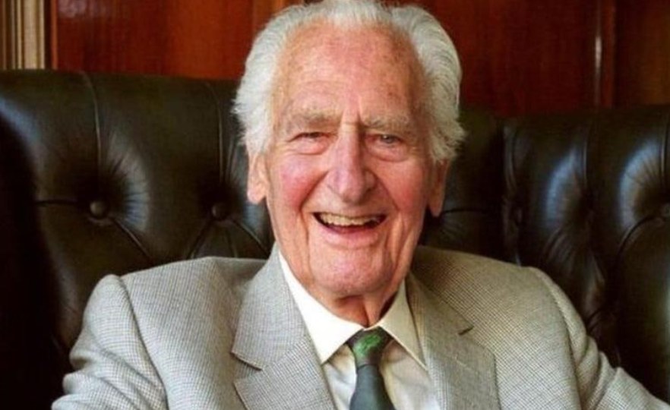
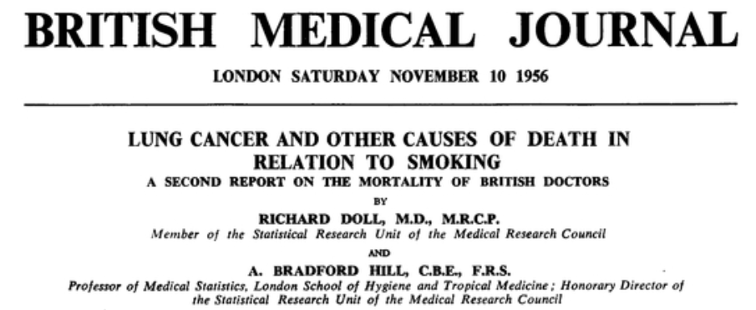

Origin for large cohorts linked to Oxford
~40,000 British doctors
(1951)
Notes:
Dreamy spires of Oxford
Arrow points to my house, and the epidemiology building where Prof Sir Richard Doll….

Slide 6
Need for LARGE studies: Coronary mortality vs systolic blood pressure (5k, 50k & 500k randomly chosen adults from PSC*)
5,000 adults
50,000 adults
500,000 adults
Age
Age
Age
256
256
80-89
256
80-89
128
128
128
70-79
70-79
64
80-89
64
64
60-69
32
32
60-69
32
70-79
50-59
CHD mortality (RR & 95% CI)
60-69
50-59
16
16
16
40-49
8
50-59
8
40-49
8
4
40-49
4
4
2
2
2
1
1
1
120
140
160
180
120
140
160
180
120
140
160
180
Systolic blood pressure (mmHg)
* Prospective Studies Collaboration
Notes:
Here is an illustration of the importance of scale.
Oxford curates a series of older prospective studies….

Slide 7
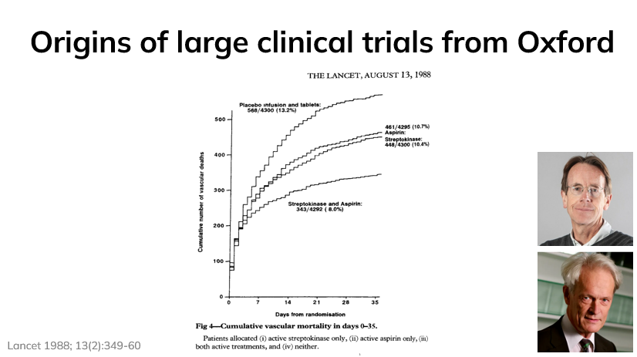
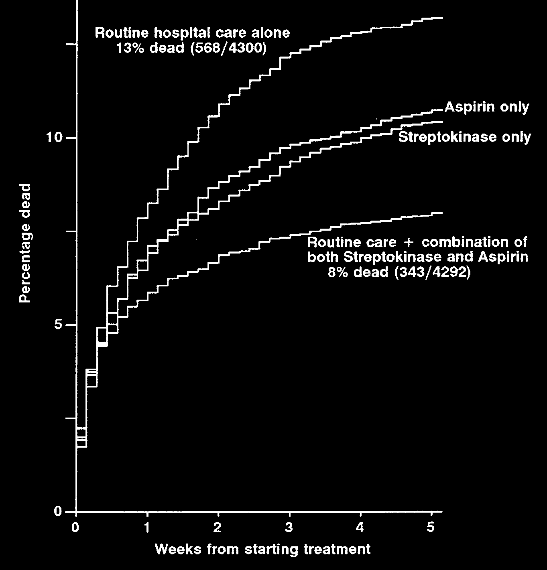
ISIS: the birth of large cardiology trials in Oxford
ISIS-2
~17,000 patients with suspected acute myocardial infarction
2x2 “factorial” trial of:
a fibrinolytic
(iv streptokinase)
&
oral aspirin
Notes:
ISIS is the main river in Oxford, before it forms the Thames.
ISIS is also the name for a series of megatrials which were the birth of large simple trials in nephrology
Masterminded by the next generation of Richard Doll
Clear results from scale, but as importantly, high impact, as streptokinase started being used widely.

Slide 8
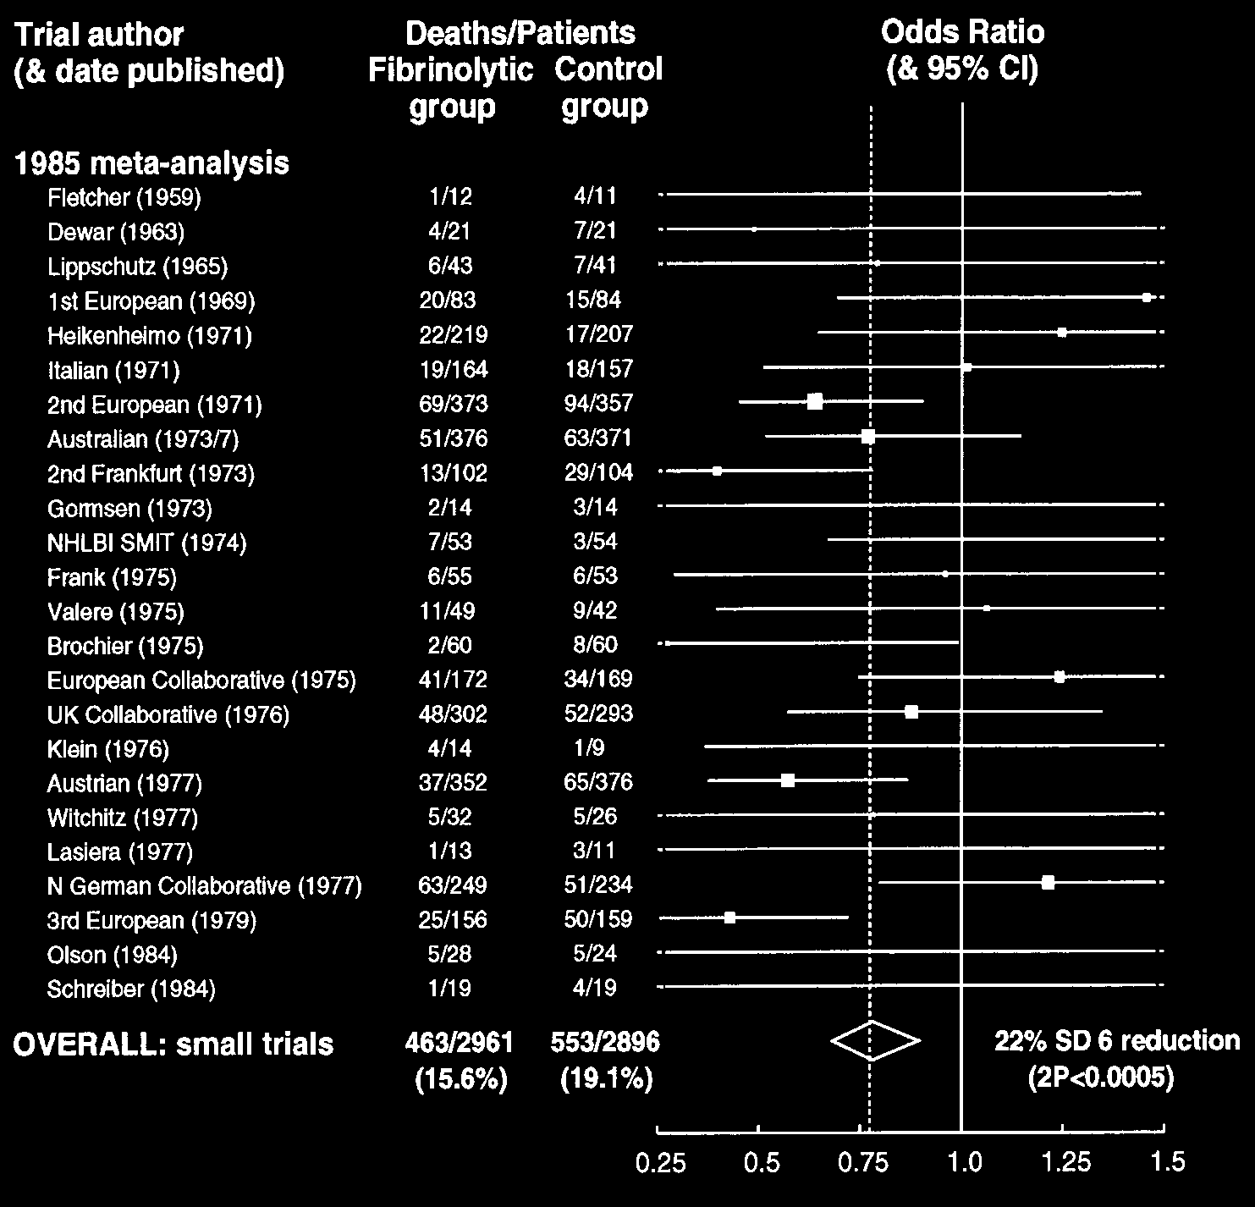
Smaller fibrinolytic trials 1959-1984 low power & no impact
“If you make a study 10x simpler, you can make it 10x larger & so 100x more informative”
Notes:
Tragedy is trials started more than 25 years previously, and 24 reported, all small….

Slide 9





Moderately large trials in CKD have established the standard of care
& IDNT
3228 pts in 2x trials in CKD & diabetes
RAS inhibitors
3533 pts with
CKD & diabetes
Semaglutide
58,816 pts in 8 trials with baseline albuminuria & serial eGFR measurements
SGLT2 inhibitors
13,026 pts in 2x large CKD trials in diabetes Finerenone
9270 pts with CKD
Statin-based therapy
CKD seminar. Lancet 2025; Nov 25th
Notes:
Last 25 years the impact of moderately large trials, starting with RENALL and IDNT and RAS inhibitors – expanding from just 1.5k to nearly 10k in a landmark effort, the SHARP trial.
Now have multiple large trials of SGLT2i collaboratively meta-analysed, as I will highlight later……

Slide 10
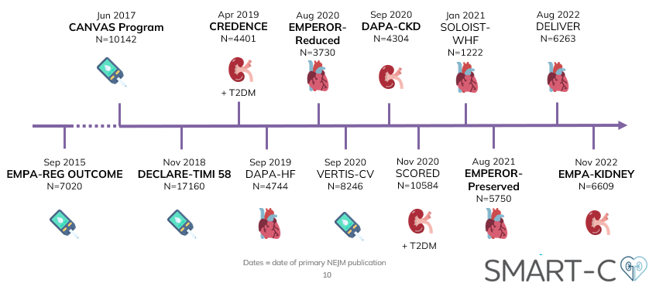
New SMART-C meta-analysis
Includes 8 large placebo-controlled trials that studied an SGLT2i with an indication for use in CKD, and reported longitudinal kidney outcomes with baseline albuminuria data:
Type 2 diabetes @high atherosclerotic risk: EMPA-REG OUTCOME, CANVAS & DECLARE-TIMI-58
Heart failure: EMPEROR REDUCED, EMPEROR-PRESERVED
CKD: CREDENCE, DAPA-CKD, EMPA-KIDNEY
JAMA 2025 Nov 7:e2520835
Notes:
The power of large trials meta-analysed collaboratively – took data from…..

Slide 11
New SMART-C meta-analysis: methods
Outcomes
eGFR slopes (emphasizing chronic slope): annualized rate of decline in eGFR calculated from the first post-randomization eGFR measurement to final follow-up on a relative scale
Kidney disease progression: composite of sustained ≥40% eGFR decline from randomization, kidney failure, or renal death
Other efficacy outcomes: AKI and hospitalization (overall and for heart failure)
Mortality: overall, and cardiovascular vs not
Safety: ketoacidosis, lower limb amputation
Placebo
SGLT2i
eGFR, mL/min/1.73m²
Overall, chronic slope 51% slower
(-54% to -49%)
doi:10.1001/jama.2025.20834
0
2
6
12
18
24
30
11
36
Months
v
.

Slide 12
Effects of SGLT2i on eGFR SLOPE by diabetes status
Relative
Relative
difference, %
DIABETES
difference, %
NO DIABETES
(95% CI)
(95% CI)
Chronic slope
Overall
-58% (-61, -54)
-43% (-52, -35)
Clear evidence of final common pathway(s) of CKD progression
-100
-50
0
50
-100
-50
0
50
SGLT2i better
Placebo better
SGLT2i better
Placebo better
JAMA 2025 Nov 7:e2520835
Notes:
51% is 58% vs 43%
Clear final common pathways
Slightly larger effect in dm

Slide 13
No clear difference in effects of SGLT2i on eGFR slopes by albuminuria status
Relative
DIABETES
Relative
NO DIABETES
difference, %
uACR
difference, %
uACR
(95% CI)
het test
(95% CI)
het test
Chronic slope (Diabetes status het test p=0.0019)
<200 mg/g
-54 (-57, -50)
0.21
-52 (-71, -32)
0.23
≥200 mg/g
-57 (-61, -53)
-39 (-47, -31)
Overall
-58 (-61, -54)
-43 (-52, -35)
-100
-50
0
50
-100
-50
0
50
SGLT2i better
Placebo better
SGLT2i better
Placebo better
uACR=urine albumin-to-creatinine ratio
JAMA 2025 Nov 7:e2520835
Notes:
Have some power to misbehave epidemiologically and perform subgroup of subgroup analyses…..

Slide 14
No clear difference in effects of SGLT2i on eGFR slopes by albuminuria status
Relative
DIABETES
Relative
NO DIABETES
difference, %
uACR
difference, %
uACR
(95% CI)
het test
(95% CI)
het test
Chronic slope (Diabetes status het test p=0.0019)
<200 mg/g
-54 (-57, -50)
0.21
-52 (-71, -32)
0.23
≥200 mg/g
-57 (-61, -53)
-39 (-47, -31)
Overall
-58 (-61, -54)
-43 (-52, -35)
Total slope (Diabetes status het test p=0.0009)
<200 mg/g
-33 (-36, -30)
0.05
-17 (-34, 1)
0.78
≥200 mg/g
-38 (-41, -35)
-19 (-27, -12)
Overall
-33 (-35, -31)
-19 (-27, -12)
-100
-50
0
50
-100
-50
0
50
SGLT2i better
Placebo better
SGLT2i better
Placebo better
uACR=urine albumin-to-creatinine ratio
JAMA 2025 Nov 7:e2520835

Slide 15
New SMART-C meta-analysis: methods
Outcomes
eGFR slopes (emphasizing chronic slope): annualized rate of decline in eGFR calculated from the first post-randomization eGFR measurement to final follow-up on a relative scale
Kidney disease progression: composite of sustained ≥40% eGFR decline from randomization, kidney failure, or renal death
Other efficacy outcomes: AKI and hospitalization (overall and for heart failure)
Mortality: overall, and cardiovascular vs not
Safety: ketoacidosis, lower limb amputation
JAMA 2025 Nov 7:e2520835
Notes:
We want to see hard clinical outcomes….

Slide 16
Beneficial relative effects of SGLT2i on “kidney disease progression*”
Hazard ratio
DIABETES
Hazard ratio
NO DIABETES
(95% CI)
(95% CI)
Kidney disease progression*
Overall
0.65 (0.60, 0.70)
0.74 (0.63, 0.85)
* Defined as a sustained ≥40% decline in eGFR, kidney failure or renal death
0.5
0.75
1
1.5
0.5
0.75
1
1.5
SGLT2i better
Placebo better
SGLT2i better
Placebo better

Slide 17
Beneficial relative effects of SGLT2i on key efficacy outcomes by diabetes status
Hazard ratio
DIABETES
Hazard ratio
NO DIABETES
(95% CI)
(95% CI)
Kidney disease progression (Het test p=0.15)
Overall
0.65 (0.60, 0.70)
0.74 (0.63, 0.85)
Acute kidney injury (Het test p=0.61)
Overall
0.77 (0.69, 0.87)
0.72 (0.56, 0.92)
Any hospitalization (Het test p=0.75)
Overall
0.90 (0.87, 0.92)
0.89 (0.83, 0.95)
Any death (Het test p=0.49)
Overall
0.86 (0.80, 0.91)
0.91 (0.78, 1.05)
0.5
0.75
1
1.5
0.5
0.75
1
1.5
SGLT2i better
Placebo better
SGLT2i better
Placebo better
JAMA 2025 Nov 7:e2520835
Notes:
Reduced risk by xxxxx……in people with and without diabetes

Slide 18
Beneficial relative effects of SGLT2i on key outcomes unmodified by level of albuminuria
Hazard ratio
DIABETES
uACR
Hazard ratio
NO DIABETES
uACR
(95% CI)
het test
(95% CI)
het test
Kidney disease progression (Diabetes status het test p=0.15)
<200 mg/g
0.95
0.24
≥200 mg/g
Overall
0.65 (0.60, 0.70)
0.74 (0.63, 0.85)
Acute kidney injury (Diabetes status het test p=0.61)
<200 mg/g
0.39
0.83
≥200 mg/g
Overall
0.77 (0.69, 0.87)
0.72 (0.56, 0.92)
Any hospitalization (Diabetes status het test p=0.75)
<200 mg/g
0.19
0.72
≥200 mg/g
Overall
0.90 (0.87, 0.92)
0.89 (0.83, 0.95)
Any death (Diabetes status het test p=0.49)
<200 mg/g
0.03
0.35
≥200 mg/g
Overall
0.86 (0.80, 0.91)
0.91 (0.78, 1.05)
0.5
0.75
1
1.5
0.5
0.75
1
1.5
SGLT2i better
Placebo better
SGLT2i better
Placebo better
JAMA 2025 Nov 7:e2520835
Notes:
Again, when results further split by uACR, no effect modification.
Why KDIGO providing different levels of evidence. Is it the benefit risk profile?

Slide 19
Relative effects of SGLT2i on safety outcomes
Hazard ratio
DIABETES
Hazard ratio
NO DIABETES
(95% CI)
(95% CI)
Ketoacidosis
Overall
2.29 (1.42, 3.71)
Lower limb amputation (Diabetes status het test p=0.31)
Overall
1.16 (1.01, 1.34)
0.85 (0.46, 1.54)
0.25
0.5
1
2
3
4
0.25
0.5
1
2
3
4
SGLT2i better
Placebo better
SGLT2i better
Placebo better
JAMA 2025 Nov 7:e2520835

Slide 20
Absolute effects of SGLT2i/1000 pt years of use
DIABETES
NO DIABETES
uACR <200mg/g
5
+0.4
+0.5
5
0
0
-0.1
-5
-4
-2
-4
-5
-4
Kidney disease progression
-10
-10
-5
-6
-15
-15
Acute kidney injury
Events avoided/caused per 1000
patient years (SE) in SGLT2i arms
-20
-16
-20
-25
-25
Hospitalization for heart failure
-30
-30
-35
-35
Any other hospitalization
-40
-40
-31
-45
-45
Cardiovascular death
Any other death
Ketoacidosis
Lower limb amputation
JAMA 2025 Nov 7:e2520835
Notes:
Title
DM split
uACR level
Run across colours

Slide 21
Absolute effects of SGLT2i/1000 pt years of use
DIABETES
NO DIABETES
uACR <200mg/g
5
+0.4
+0.5
5
0
0
-0.1
-5
-4
-2
-4
-5
-4
Kidney disease progression
-10
-10
-5
-6
-15
-15
Acute kidney injury
Events avoided/caused per 1000
patient years (SE) in SGLT2i arms
-20
-16
-20
-25
-25
Hospitalization for heart failure
-30
-30
-35
-35
Any other hospitalization
-40
-40
-31
-45
-45
Cardiovascular death
uACR ≥200 mg/g
+0.9
+2
Any other death
5
5
0
0
-0.1
Ketoacidosis
-5
-5
-4
-2
-10
-5
-7
-10
Lower limb amputation
-15
-15
Events avoided/caused per 1000
patient years (SE) in SGLT2i arms
-20
-20
JAMA 2025 Nov 7:e2520835
-25
-25
-19
-30
-23
-30
-24
-35
-31
-35
-40
-40
-45
-45
Absolute effects for lower limb amputation (excluding CANVAS): +0.1 for uACR <200 mg/g and +0.4 for uACR ≥ 200 mg/g
Notes:
Now look at higher levels of albuminuria
Even larger benefits on KDP – of course, they are at much higher risk of progression.
Slightly larger benefit on AKI and hospitalization t

Slide 22
Absolute effects of SGLT2i/1000 pt years of use (excluding heart failure trials)
DIABETES
NO DIABETES
uACR <200mg/g
5
+0.3
+0.5
5
0
0
-0.1
Kidney disease progression
-5
-3
-1
-3
-5
-5
-2
-10
-10
-6
Acute kidney injury
-15
-15
Events avoided/caused per 1000
patient years (SE) in SGLT2i arms
-14
-20
-20
-25
-25
-20
Hospitalization for heart failure
-30
-30
-35
-35
Any other hospitalization
-40
-40
-45
-45
Cardiovascular death
uACR ≥ 200 mg/g
Any other death
5
+0.7
+2
5
0
0
-0.1
Ketoacidosis
-5
-5
-5
-4
-1
-10
-6
-10
Lower limb amputation
-15
-15
Events avoided/caused per 1000
patient years (SE) in SGLT2i arms
-20
-20
-14
-25
-21
-25
-30
-30
-25
-35
-31
-35
-40
-40
-45
-45
JAMA 2025 Nov 7:e2520835
Notes:
Hospitalization not driven by heart failure trials….

Slide 23
Key findings from meta-analysis of ~60,000 participants from large SGLT2i trials
SGLT2i reduce:
Chronic rate of eGFR decline by 58% in diabetes & 43% without
Risk of the composite of kidney disease progression based on a ≥40% decline in eGFR by 26-35%
Risk of acute kidney injury by about one-fifth
Risk of hospitalization from any cause by ~10%
Clear evidence of final common pathway(s) of CKD progression
(points to renal tubular protection)
Better to study a range and compare, than start with an overly precise population
JAMA 2025 Nov 7:e2520835

Slide 24
Key findings from meta-analysis of ~60,000 participants from large SGLT2i trials
Relative risks for outcomes similar in analyses stratified by diabetes status, and then by baseline uACR ≥200 vs <200 mg/g
Substantial net absolute benefits irrespective of diabetes status or uACR, with particularly large benefits on risk of hospitalization
These data support removal of stratification by level of albuminuria from SGLT2i guideline recommendations
JAMA 2025 Nov 7:e2520835

Slide 25
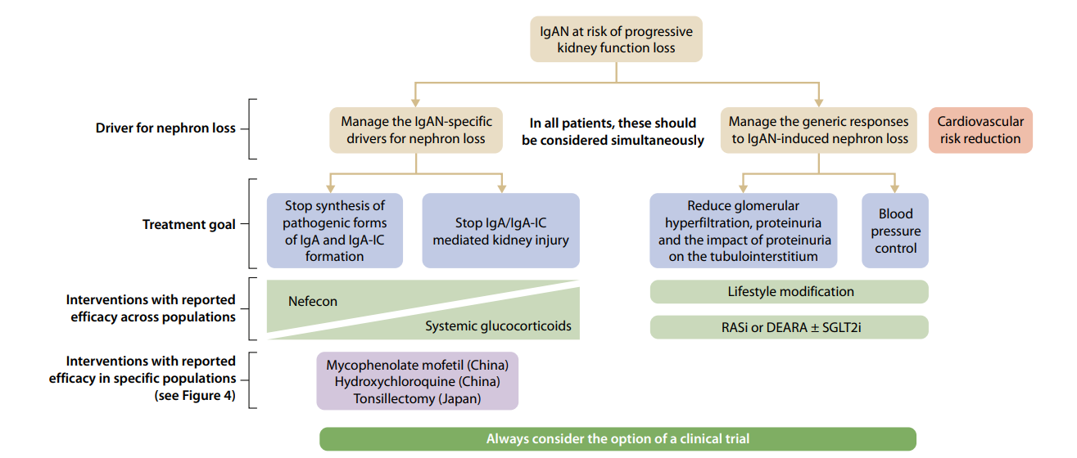

But what about using SGLT2i use in my patient with IgA nephropathy?
definitely powered
^
2025 KDIGO IgAN guidance
Notes:
Great to see KDIGO encouraging targeting final common pathway simultaneously with disease specific treatment.
I was a bit surprised SGLT2 were second line behind RASi or ERA…….the data are worth revisiting…….

Slide 26
But what about using SGLT2i use in my patient with IgA nephropathy?
definitely powered
^
2025 KDIGO IgAN guidance
Notes:
Great to see KDIGO encouraging targeting final common pathway simultaneously with disease specific treatment.
I was a bit surprised SGLT2 were second line behind RASi or ERA…….the data are worth revisiting…….

Slide 27
EMPA-KIDNEY: Annual rate of change of eGFR
40
Empagliflozin
Placebo
35
eGFR, mL/min/1.73m²
30
-50% (-58 to -42) slower chronic eGFR slope/year
Empagliflozin | Placebo | Difference (95% CI)
-1.37 (0.08) | -2.75 (0.08) | 1.37 (1.16, 1.59)
25
0
2
6
12
18
24
30
36
Months
N Engl J Med 2023;388:117-127
v
.
Notes:
Best data on igaN from EMPA-KIDNEY
Overall result provided here as a reminder

Slide 28
EMPA-KIDNEY: Chronic eGFR slopes by primary kidney diagnosis
Mean (SE) slope, mL/min/1.73m²/year
Absolute difference (95% CI),
mL/min/1.73m²/year
Relative difference (95% CI), %
P_{het}
CHRONIC SLOPE
Causes of kidney disease
Diabetic kidney disease
Hypertensive/renovascular Glomerular disease
Other disease/unknown
All participants
Empagliflozin
Placebo
p=0.11
-1.16 (0.14)
-2.81 (0.14)
-59 (-73, -45)
-0.84 (0.17)
-2.20 (0.17)
-62 (-83, -41)
-2.17 (0.16)
-3.60 (0.16)
-40 (-52, -28)
-1.29 (0.17)
-2.25 (0.17)
-42 (-63, -22)
-1.37 (0.08)
-2.75 (0.08)
1.37 (1.16, 1.59)
-50 (-58, -42)
-1
-0.5
0
0.5
1
1.5
2
-100
-50
0
50
Placebo Better
Empagliflozin Better
Empagliflozin Better
Placebo Better
Difference in mean eGFR slopes (mL/min/1.73m²/yr)
Difference in slopes as % of the placebo slope
Lancet Diab. & Endo. 2024 12(1): 51-60
Notes:
State % per disease, and kidney benefit in all

Slide 29
EMPA-KIDNEY: Chronic eGFR slopes by type of glomerular disease
Mean (SE) slope, mL/min/1.73m²/year
Absolute difference (95% CI),
mL/min/1.73m²/year
Relative difference (95% CI), %
P_{het}
CHRONIC SLOPE
IgA nephropathy
FSGS
Other glomerulonephritis
All participants*
Empagliflozin
Placebo
p=0.58
-2.33 (0.24)
-4.12 (0.24)
-43 (-59, -27)
-2.66 (0.47)
-3.39 (0.46)
-22 (-60, 16)
-2.05 (0.25)
-3.50 (0.26)
-41 (-62, -21)
-1.37 (0.08)
-2.75 (0.08)
1.37 (1.16, 1.59)
-50 (-58, -42)
-1
-0.5
0
0.5
1
1.5
2
-100
-50
0
50
Placebo Better
Empagliflozin Better
Empagliflozin Better
Placebo Better
Difference in mean eGFR slopes (mL/min/1.73m²/yr)
Difference in slopes as % of the placebo slope
* Total row includes participants without glomerular disease
Lancet Diab. & Endo. 2024 12(1): 51-60
Notes:
Split glomerular disease, and 815 pts with known IgAN……one of the fastest progressing groups at over 4ml/min/year, and not selected for high uACR like the IgAN trials.

Slide 30

SMART-C: KIDNEY DISEASE PROGRESSION
in IgA nephropathy
1087 patients with known IgAN
Events/participants
SGLT2i
Placebo
Relative risk (95% CI)
IgA nephropathy
DAPA-CKD
EMPA-KIDNEY
Subtotal
37/550
68/537
0.49 (0.32, 0.74)
ANY GLOMERULAR DISEASE
90/1196
141/1168
0.60 (0.46, 0.78)
0.25
0.5
0.75
1
1.5
SGLT2i better
Placebo better
Kidney disease progression defined as a sustained ≥50% eGFR decline from randomization, kidney replacement therapy, sustained low eGFR (e.g. <10 or <15), or renal death
Lancet 2022; 400: 1788–801
Notes:
SMART-C……

Slide 31
Overwhelming evidence to support SGLT2i use widely in IgA nephropathy?
1087 pts with known IgAN in SGLT2i trials: clear evidence chronic eGFR declines slowed by ~40%
Incredibly safe in non-diabetic populations (trial data from ~21,000 patients with CKD), with no important effect modification by age or eGFR
Additional benefits on AKI, heart failure, hospitalization & mortality
SGLT2i are cost-effective in CKD, and generics will be even better
Lancet 2022; 400: 1788–801
JAMA 2025 Nov 7:e2520835
Lancet Diab. & Endo. 2024 12(1): 39-504
EClincalMedicine 2025 Jul 8:85:103338

Slide 32

Potential negative impact of
orphan drug designation & small trials
Prediction: nephrology will see other new drugs which target final common pathways of progression only superficially tested
(e.g. short-term surrogate outcome trials in single primary diseases)
WARNING: This leads to less information on efficacy & safety, narrow indications for use, & high pricing
Notes:
Sparsentan
sGC inhibitors

Slide 33
Part 1: Summary
SGLT2i trials illustrate the value of large-scale randomization of a broad range of patients at risk of CKD progression
New standard of care in CKD to manage cardiorenal risk
Highly effective at targeting final common pathways of progression
Have answered “precision medicine” questions after trials’ completion (E.g. effect by albuminuria, or in IgA nephropathy)

Slide 34
Part 2: New biomarker data from EMPA-KIDNEY encourage expanded focus beyond the concept of intraglomerular hypertension, and towards the tubules

Slide 35
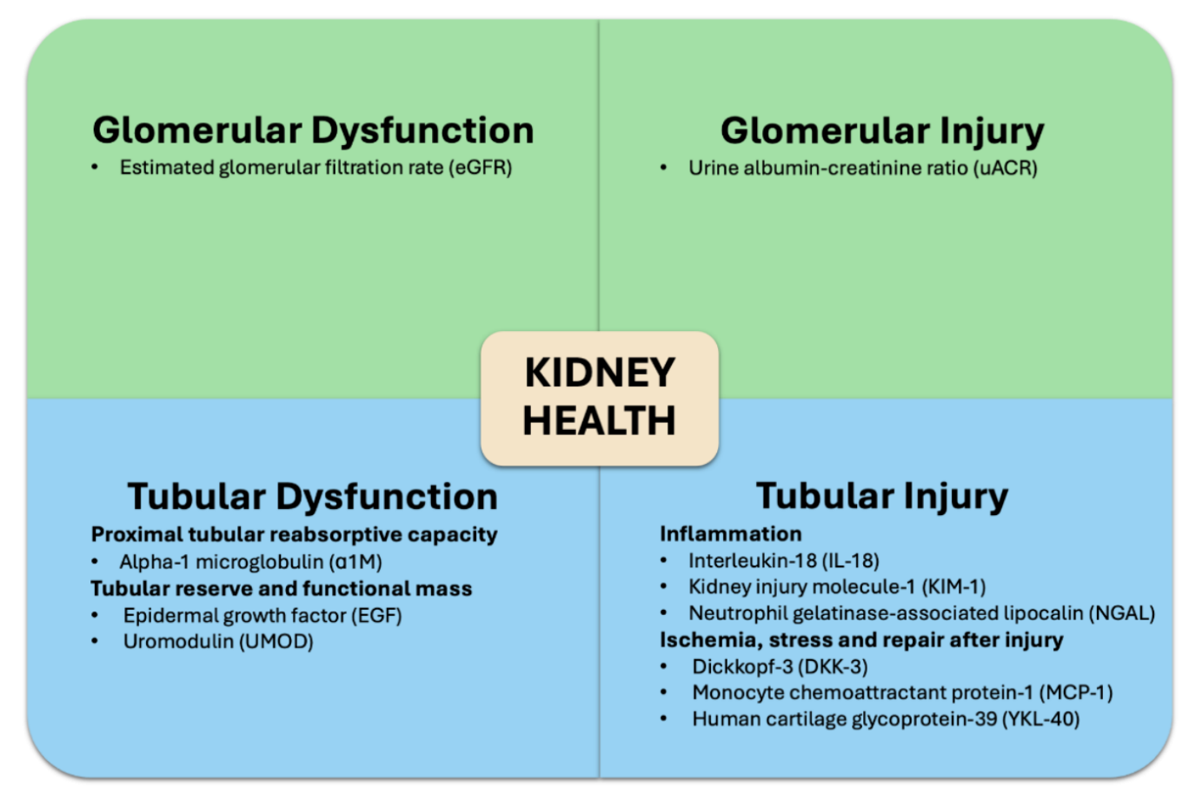

EMPA-KIDNEY biobank
What are the effects of empagliflozin on urine protein, albumin, and markers of tubular health? (2752 patients with 2 & 18 month tests)

Slide 36
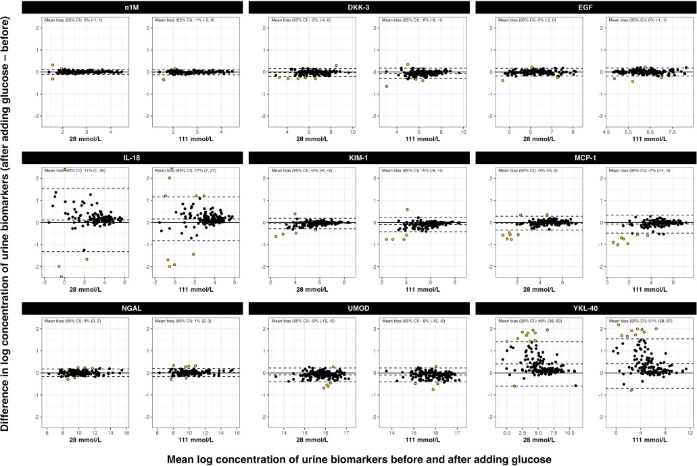
Glucose interference in assays?
Beware: urine IL-18 and YKL-40 assays in multiplex affected by urine glucose
Kidney International Reports. 2025;10(11):4090-4093. doi:10.1016/j.ekir.2025.09.009

Slide 37
Effects of empagliflozin versus placebo on
study average levels of urine biomarkers
Absolute values indicate geometric mean (SE) urine biomarker-to-creatinine ratio (mg/g for ACR, PCR, non-albumin PCR, A1M, and UMOD; ng/g for the rest of the biomarkers). The size of the boxes represents the amount of information estimated.
Compared to placebo, allocation to empagliflozin did not result in differences in urine sodium and resulted in 6652% greater urine glucose at 18 months.
AJKD 2025; ePub

Slide 38
Effects of empagliflozin versus placebo on
study average levels of urine biomarkers
Absolute values indicate geometric mean (SE) urine biomarker-to-creatinine ratio (mg/g for ACR, PCR, non-albumin PCR, A1M, and UMOD; ng/g for the rest of the biomarkers). The size of the boxes represents the amount of information estimated.
Compared to placebo, allocation to empagliflozin did not result in differences in urine sodium and resulted in 6652% greater urine glucose at 18 months. Uromodulin findings have been replicated by external expert laboratory using at least 2 different assays.
AJKD 2025; ePub

Slide 39
Consistent effects of empagliflozin on
uromodulin by subgroups
Absolute values indicate geometric mean (SE) urine uromodulin to creatinine ratio (mg/g). The size of boxes represents the amount of information estimated. P values derived for test for heterogeneity for diabetes and primary cause of kidney disease subgroups and test for trend for eGFR and uACR subgroups.
AJKD 2025; ePub

Slide 40
Proportion of treatment effect on chronic eGFR slope explained by biomarkers at 2 months
Mediators | Proportion of Treatment Effect
Urine albumin:creatinine ratio (uACR) | 15% (9 to 22)
Alpha-1 microglobulin | -12% (-20 to -7)
Dickkopf-3 | -4% (-8 to -1)
Epidermal growth factor | -0% (-2 to 2)
Kidney injury molecule-1 | -4% (-10 to -1)
Monocyte chemoattractant protein-1 | -3% (-8 to 1)
Neutrophil gelatinase-associated lipocalin | -1% (-3 to 1)
Uromodulin | 19% (4 to 37)
uACR + Uromodulin | 32% (15 to 52)
Analyses restricted to 2561 participants with measurements of uACR, SBP, DBP, HbA1c and creatinine-indexed urine biomarkers at 2 months and a minimum of 2 eGFR measurements between 2 months and the final follow-up visit. The proportion of treatment effect explained by on-study biomarkers is estimated using the landmark method, adjusting a linear regression model with chronic slope as the dependent variable for 2 month values of the biomarkers. Models were adjusted for biomarkers at 2 months; all analyses were additionally adjusted for baseline variables specified in the minimization algorithm (age, sex, prior diabetes, eGFR, uACR, region).
AJKD 2025; ePub

Slide 41
Raised urine uromodulin:
further translational research required
One of the most abundant proteins secreted by health kidney tubules with diverse roles
Genetic studies suggest higher levels associated with fast progression
Mechanism of how SGLT2i effect uromodulin production in the distal tubules is unclear.
Notes:
Could it be altered trafficking or excretion through tubular cross-communication in the kidney cortex?

Slide 42
Part 2: Summary
Empagliflozin appears to substantially reduce urine uromodulin
(& causes moderate elevates in urine α1-microglobulin & dickkopf-3)
Empagliflozin did not affect other markers of tubular function reserve, injury, and ischaemia (e.g., epidermal growth factor, KIM-1, & monocyte chemoattractant protein-1)
Are uromodulin and the renal tubules the key to identifying more final common pathways of kidney disease progression?

Slide 43
Vast trial saving tiny nephrons: identifying key common pathways to kidney failure
Large SGLT2i trials confirmed the biological concept of final common pathways AND have established a new standard of care for CKD
Greatest CKD population benefits on kidney outcomes likely to be achieved by identifying safe interventions which target these pathways
SGLT2i are a perfect example with clear benefits in large trials including a wide range of patient at risk of CKD progression
“Precision medicine” questions explored once large trials are completed +/- combined: important benefits even at low levels of albuminuria, and in single diseases (e.g. IgAN)
New biomarker data from EMPA-KIDNEY encourage expanded focus beyond the concept of intraglomerular hypertension, and towards the tubules
Thank you for listening &
cherishing large trials!

