Slide 1


Clinical Significance of Donor Quality for Predicting Long-term Post-transplant Outcomes
Jaeseok Yang, MD, PhD
Division of Nephrology, Department of Internal Medicine,
Severance Hospital, Yonsei University College of Medicine
Notes:
Thank chairmen for your kind introduction.
Good morning everyone! I am Jaeseok Yang, a Korean transplant nephrologist and immunologist.
I would like to discuss how to measure donor quality for predicting post-transplant outcomes.

Slide 2
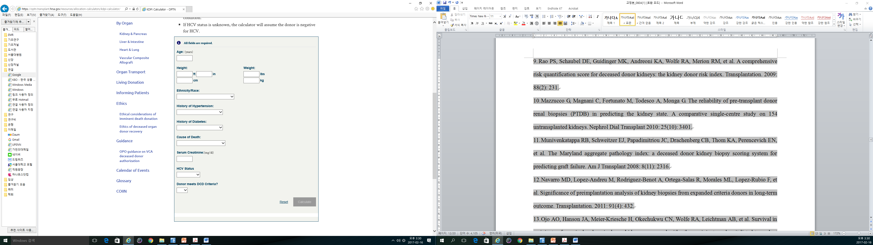
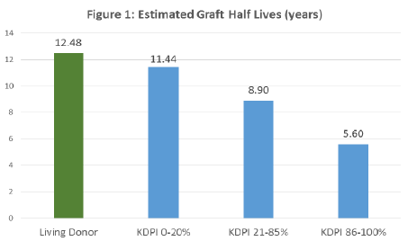
Assessment of Deceased Donor Quality in UNOS
Previous dichotomous ECD criteria
Donor age ≥ 60 years or
Donor age 50 to 59 years + ≥2
History of HT
CVA as the cause of death
Serum creatinine >1.5 mg/dL
Current ECD criteria
KDRI: 10 prognostic factors → 8
KDPI: 0-100%
<20%, 20≤<80%, ≥85%
ECD with bad quality (KDPI ≥ 85%)
Integrated distribution irrespective of local and regional priority
Notes:
Let’ start with deceased donor quality.
UNOS changed donor quality assessment tool from dichotomous ECD criteria to more sophisticated, continuous KDPI using 10 or 8 prognostic factors.

Slide 3
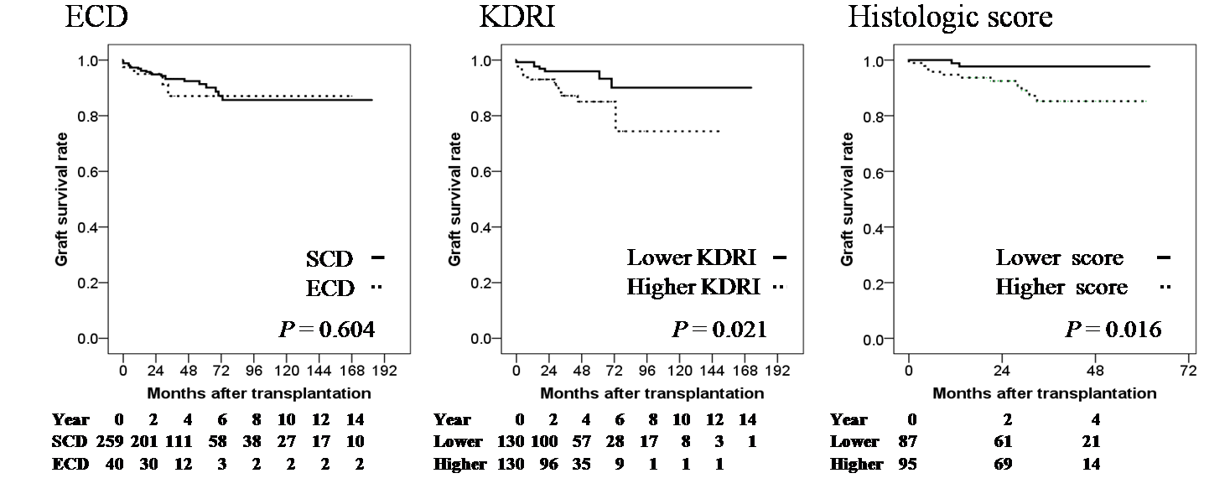
Korean Old ECD Criteria
Previous KONOS criteria of dichotomous ECD/SCD criteria
Donor age ≥ 60 years
DCD
hypotensive attack ≥ 3 episodes
serum creatinine >3.0 mg/dL or Clcr < 60 mL/min
Yang J et al. Clin Transplant 2014
Notes:
Korea used to use dichotomous ECD/SCD criteria based on these criteria.
However, graft survival rates were similar between ECD and SCD based on these criteria, whereas survival difference was found by new US-KDPI or zero-time biopsy findings.

Slide 4
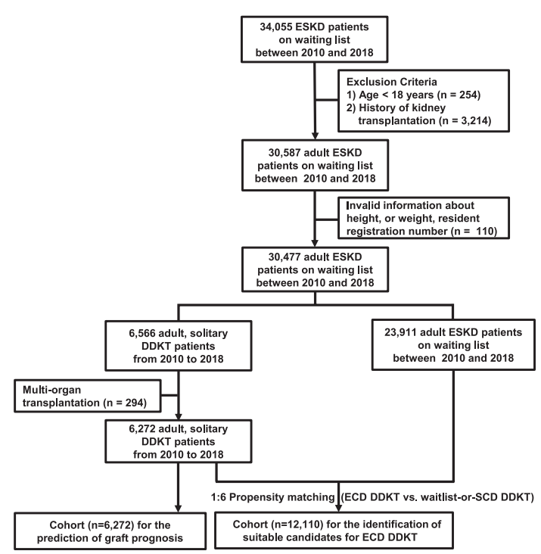
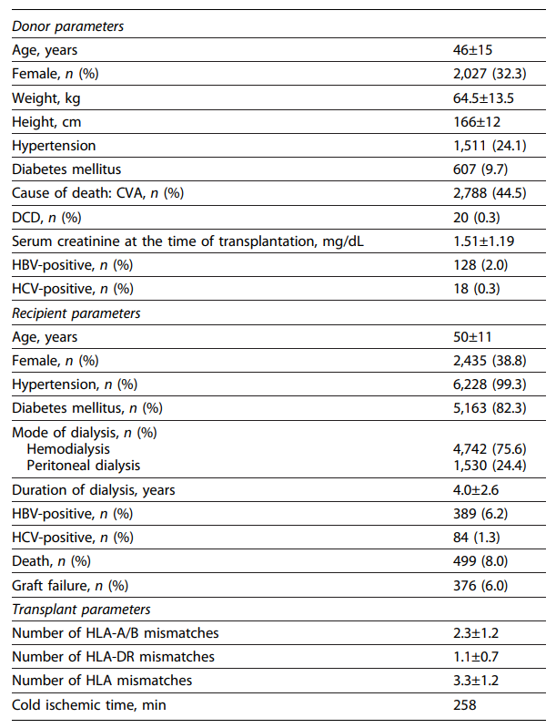
Development of Korean KDRI & KDPI
Notes:
Therefore, we tried to develop new Korean KDPI using our own national database between 2010 and 2018.

Slide 5
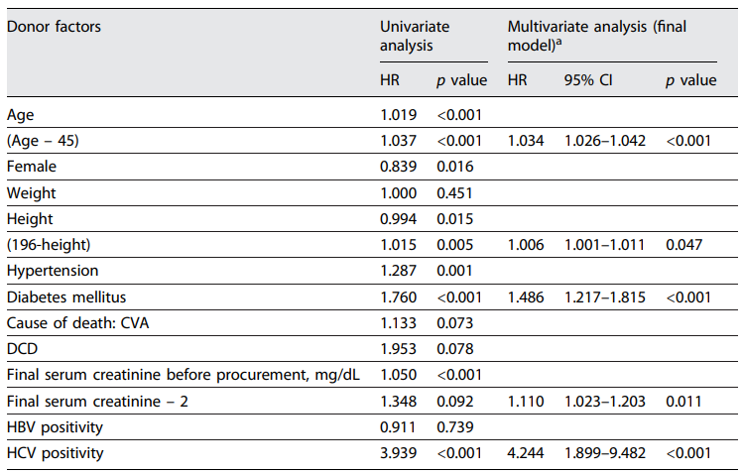
Development of Korean KDRI & Conversion to KDPI
Yang J et al Kidney Dis 2025;11(1):143-153
Notes:
Five prognostic factors, such as age, height, DM, serum creatinine, and HCV, were independently and significantly associated with graft failure.
Based on these data, Korean KDRI formula was made as follows, and converted to percentage scale, KDPI.

Slide 6
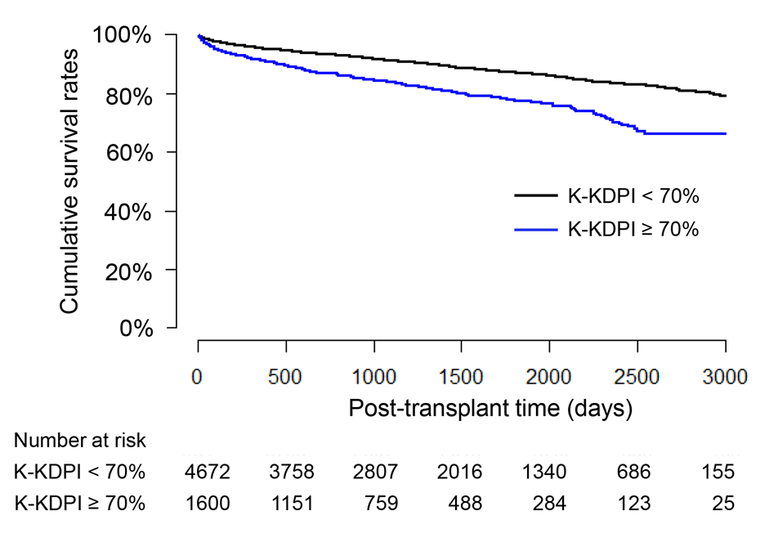
New ECD Criteria: K-KDPI ≥ 70%
Model | Discrimination C | 95% CI of discrimination C | Differences in UNO’s concordance Statistics (P value)
K-KDPI | 0.600 | 0.578–0.617 | Reference
UNOS-KDPI | 0.552 | 0.473–0.637 | 0.012
Dichotomous ECD criteria of UNOS | 0.556 | 0.473–0.637 | 0.020
Dichotomous ECD criteria of KONOS | 0.557 | 0.464–0.628 | <0.001
Notes:
Discrimination power of K-KDPI was moderate.
When K-KDPI 70% or higher was defined as ECD, there was significant survival difference between ECD and SCD.

Slide 7
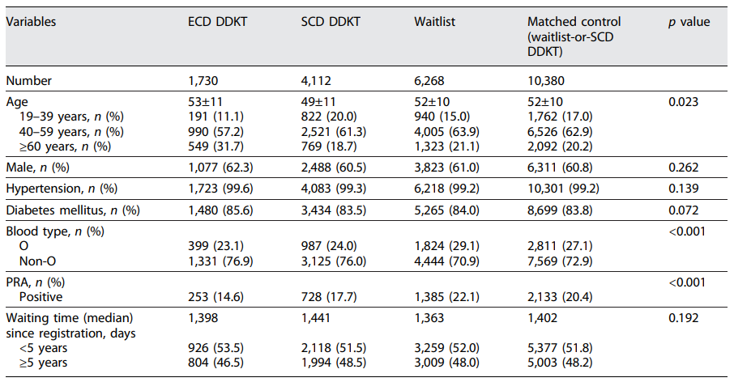
Comparison between ECD vs. SCD/Waitlist
Notes:
Next, we investigated the criteria for suitable candidates for ECD DDKT compared with waiting or SCD DDKT.

Slide 8
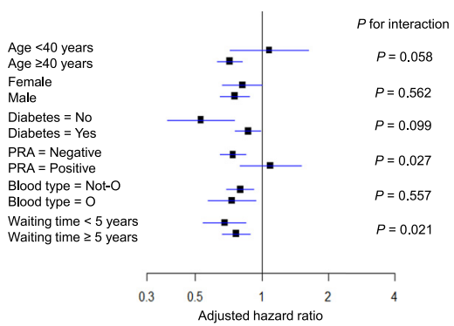
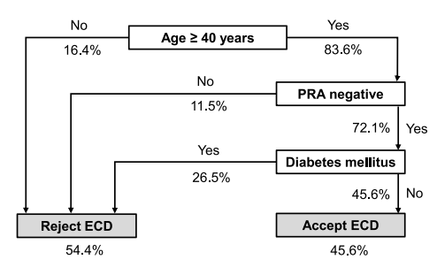
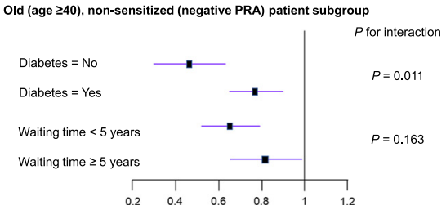
Comparison between ECD vs. SCD/Waitlist
Yang J et al Kidney Dis 2025;11(1):143-153
Notes:
Survival benefit of ECD was found in subgroups of old age or negative PRA.
In the old, non-sensitized subgroup, survival benefits were more remarkable in non-diabetic patients.
Based on these results, we made decision algorithm as follows;
Old, non-sensitized, non-diabetic waitlisted patients had better receive ECD DDKT rather than waiting for future SCD DDKT

Slide 9
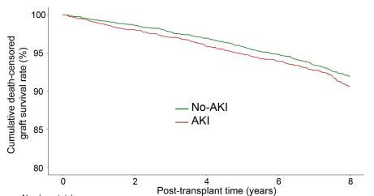
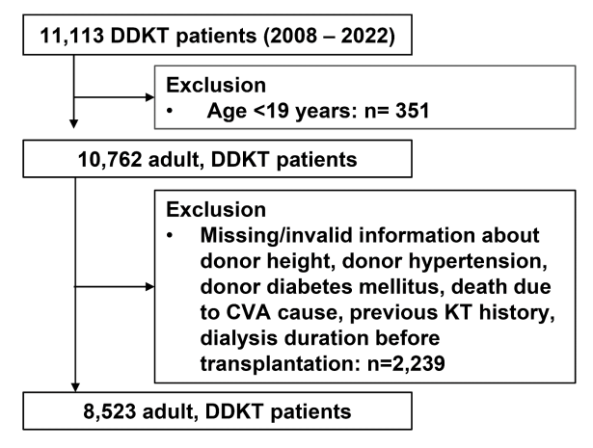
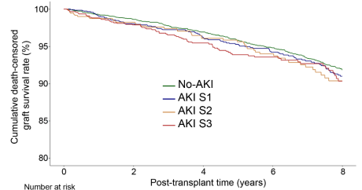
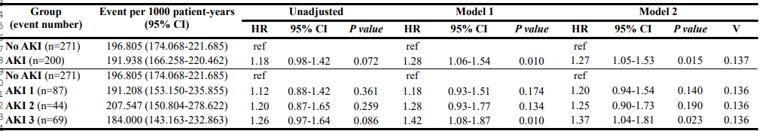
Role of AKI Kidneys in DDKT
Notes:
Donor shortage is severe in Asian countries and therefore appropriate utilization of AKI kidneys is an important issue.
We analyzed 8,523 adult DDKT patients from Korean national database
and found AKI, especially stage 3 AKI, significantly decreased graft survival rates.

Slide 10
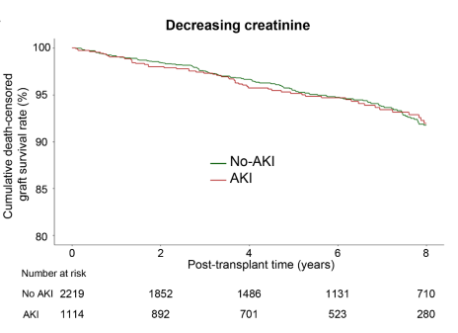
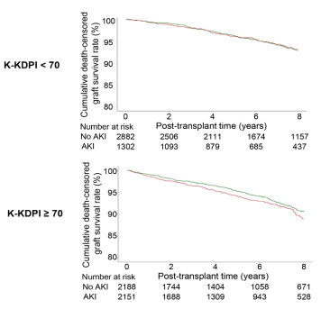
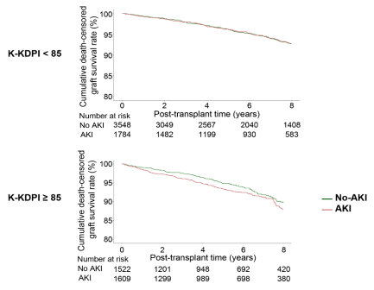
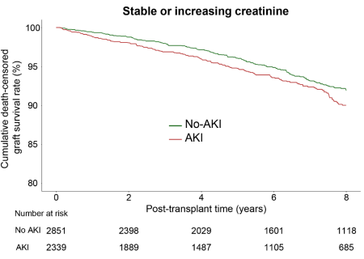
Role of AKI Kidneys in DDKT
Yang J et al Unpublished
Notes:
Interestingly, impact of AKI was significant only in ECD group, like K-KDPI > 70 or 85%.
Furthermore, impact of AKI was not significant in decreasing creatinine patterns.
Taken together, we could safely use stage 1 or 2 AKI, especially in SCD or decreasing creatinine patterns to overcome organ shortage.

Slide 11
Prognosis of DDKT according to Combinations of KDPI and EPTS
EPTS (Estimated Post-Transplant Survival)
Prognostic index of transplant recipients
K-EPTS = 0.0152 x [age – 50 (years)] + 0.4192 x I[diabetes] + 0.6746 x I[HCV] )
- 0.0678 x [dialysis duration (years)] + 0.0393 x [age – 50 (years)] x I[diabetes]
+ 0.0046 x [age – 50 (years)] x [dialysis duration (years)]
[ I(A) is set to 1 if condition A is applies to the donor kidney of interest and otherwise it is set to 0]
Classification of DDKT according to combination of KDPI and EPTS
Class I: low K-KDPI (<70%) to low K-EPTS (<20%)
Class II: low K-KDPI (<70%) to high K-EPTS (≥ 20%)
Class III: high K-KDPI (≥ 70%) to low K-EPTS (<20%)
Class IV: high K-KDPI (≥ 70%) to high K-EPTS (≥ 20%)
Yang J et al. Korean J Transplant 2021;35(2):86-92
Notes:
For recipient prognostic factors, we developed Korean EPTS based on four prognostic factors, such as age, DM, HCV, dialysis duration.
Then, we matched K-KDPI and K-EPTS and compared mortality of four groups.

Slide 12
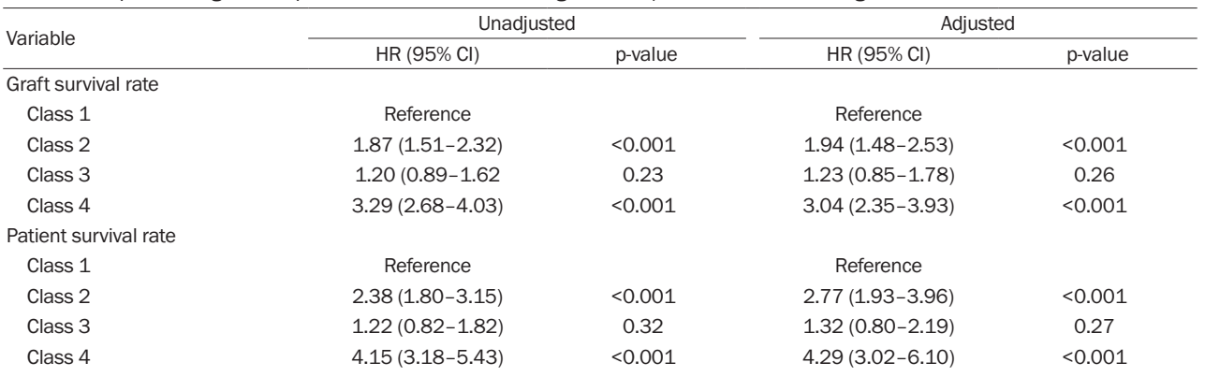
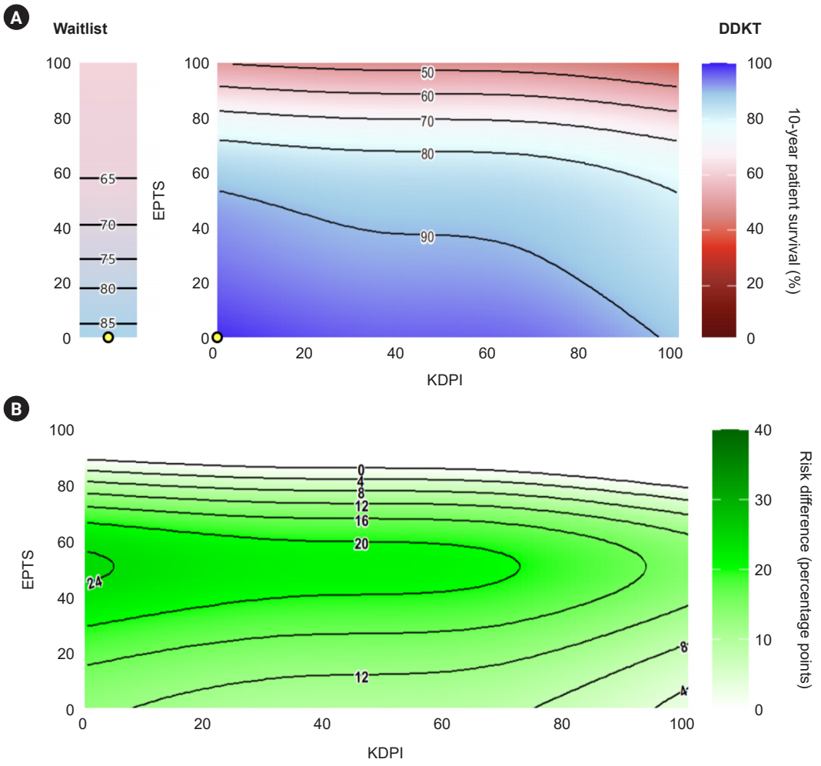
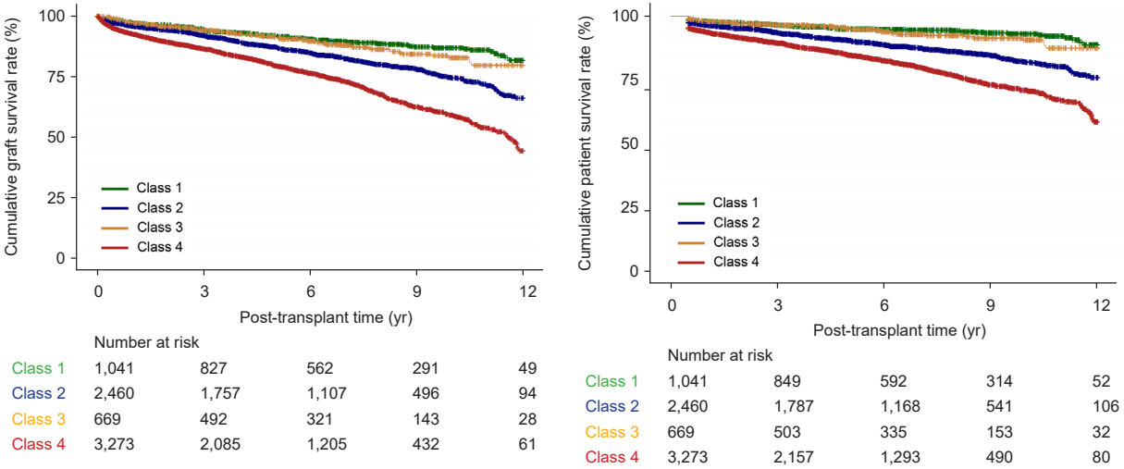
Prognosis of DDKT according to Combinations of KDPI and EPTS
Class I: low K-KDPI to low K-EPTS
Class II: low K-KDPI to high K-EPTS
Class III: high K-KDPI to low K-EPTS
Class IV: high K-KDPI to high K-EPTS
Yang J et al Kidney Res Clin Pract 2025
Notes:
Prognosis of high to high and low to high was bad, however, high to low has good prognosis.
Therefore, we plan to preferentially allocate good kidneys to good recipients but won’t adopt policy of bad kidneys to bad recipients.
These data suggest that we should consider donor quality together with recipient conditions.

Slide 13
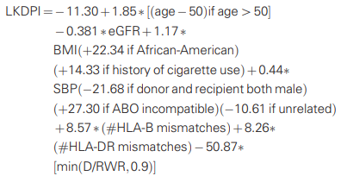
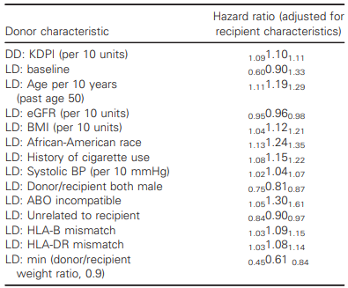
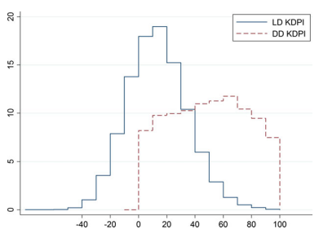
LD-KDPI: Living Donor-Kidney Donor Profile Index
SRTR: 36,025 LDKT, 69,994 DDKT patients
Median 12.8 (-0.8 ~ 27.2)
Notes:
Johns Hopkins group developed Living donor KDPI from SRTR on the same scale as the DD KDPI.
Distribution of LD-KDPI was skewed to left to DD-KDPI, indicating LD had better overall quality than DD; however, some DD seemed to have better quality than LD.

Slide 14
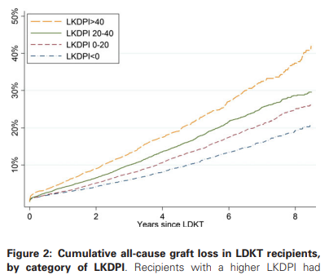
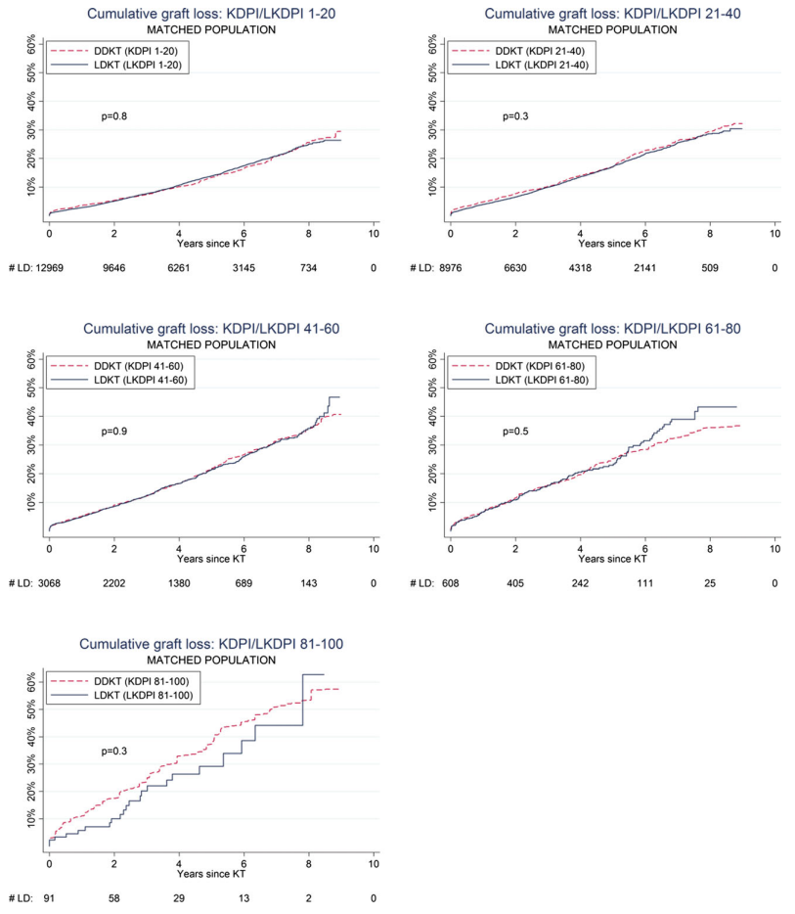
Prognostic Values of LD-KDPI in USA
C statistic
LD-KDPI (0.59) vs. DD-KDPI (0.58)
Notes:
LD-KDPI has good prognostic values in US
And LD-KDPI has similar prognosis as DD-KDPI with similar scores.

Slide 15
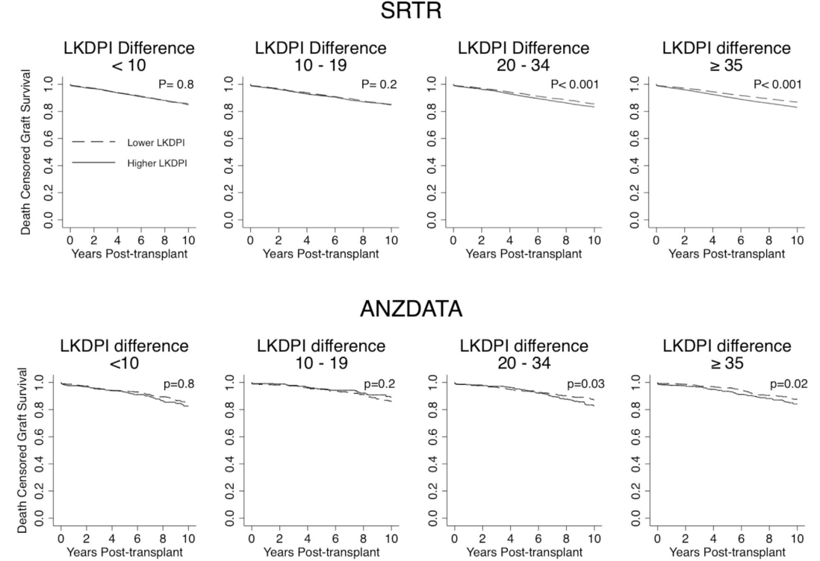
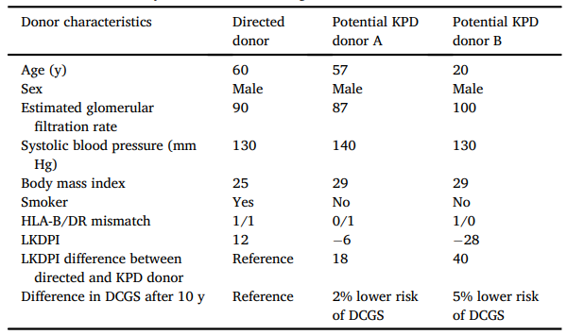
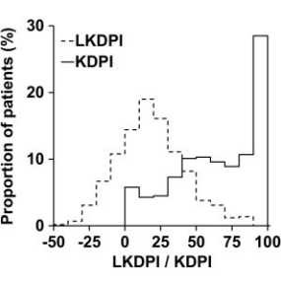
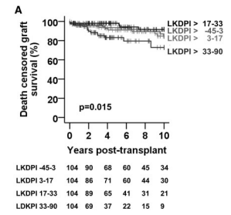
Validation of LD-KDPI in the Western Countries
German single center: 416 LDKT, 889 DDKT patients Nephrol Dial Transplant 2019;34:1063
Median LD-KDPI 17, DD-KDPI 69
DCGS: significant difference among LD-KDPI (-45~3, 3~17, 17~33, 33-90)
Lower predictive power: ROC analysis – LD-KDPI 0.55 < DD-KDPI 0.66
SRTR (65,388)/ANZDATA (4,524) LDKT patients Am J Transplant 2023;23:232
DCGS: addition of LD-KDPI to reference model increased C statistic by only 0.02
C statistic in Cox model to determine association of LD-KDPI with DCGS was weak (0.51-0.54)
Notes:
German and Australian group validated LD-KDPI.
German group found predictive power of LD-KDPI was lower that of DD-KDPI.
ANZDATA group showed addition of LD-KDPI to reference model increased C statistic by only 0.02 and C-statistic to determine association of LD-KDPI w DCGS was weak (0.51 to 0.54).

Slide 16
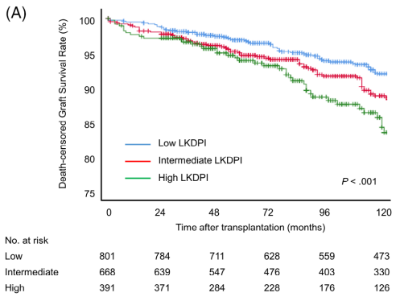
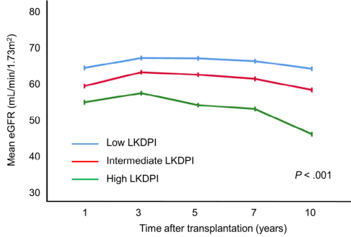
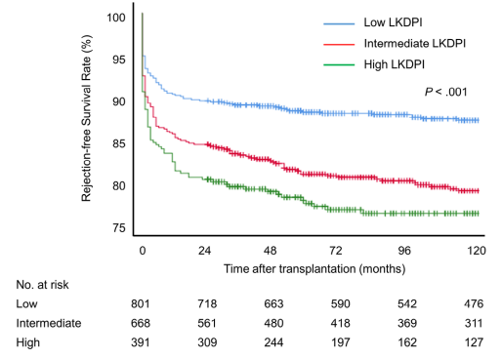
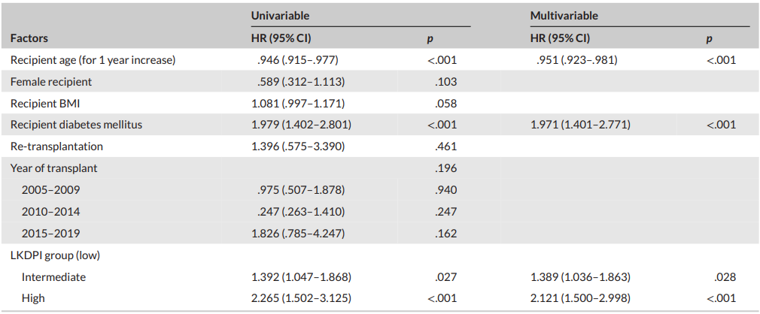
Validation of LD-KDPI in Asia
Korean single center: 1,860 LDKT patients Clin Transplant 2024;38:e15178
Median LD-KDPI score 3.11 (-8.9 – 16.7)
Death-censored graft survival: LD-KDPI <0, 1–19.9 (HR 1.389), ≥20 (HR 2.121)
Notes:
In Asia, my center performed singe center validation study and found that LD-KDPI has good prognostic values.

Slide 17
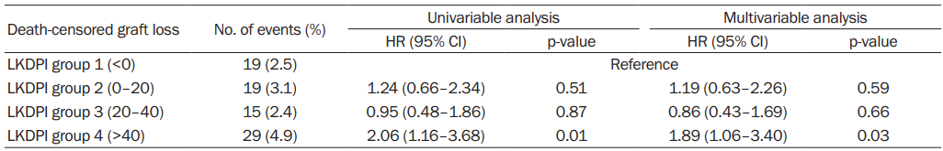
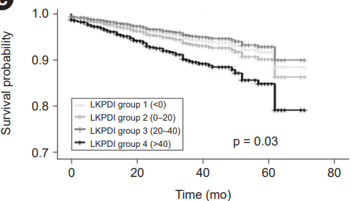
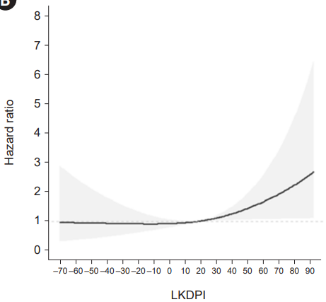
Validation of LD-KDPI in Asia
Korean nationwide cohort: 2,598 LDKT patients Kidney Res Clin Pract 2025;44:189
Median LKDPI score 15.5
Death-censored graft survival: LD-KDPI <0, 0–20, 20-40, >40
Notes:
Another Korean nationwide cohort study found only worst LD-KDPI group has significantly worse DCGS rate similarly as in ANZDATA.

Slide 18
Critic for LD-KDPI
Limited predictive value for discrimination of model in US study
Concordance index = 0.59
Controversial results in external validation studies
Modest increase in C-statistic by addition of LKDPI in SRTR/ANZADATA
C statistic in Cox model to determine association of LKDPI with DCGS was 0.51-0.54
Significant lower death-censored graft survival only in LKDPI > 20 or 40
Unfair comparison between living and deceased donors using LD- and DD-KDPI
LKDPI is set to have similar prognosis of LDKT as DDKT with the same value of KDPI
Some overlap between LD-KDPI and DD-KDPI and even better DD-KDPI than LD-KDPI
Only 4% of living donors had a risk index higher than the median DD-KDPI
Little chance to compare deceased donors and potential living donors at the same time
Risk of morbidity and mortality during dialysis waiting for better DD-KDPI than LD-KDPI
Notes:
Initial US study showed predictive value of LD-KDPI is modest.
External validation in both Western countries and Korea also suggest prognostic value of LD-KDPI is modest.
LD-KDPI is set to have similar prognosis of LDKT as DDKT with the same value of DD-KDPI/
However, practically we have little chance to compare DD and potential LD at the same time
Comparison between LD and DD may be unfair because mortality during dialysis is high waiting for better DD-KDPI than LD-KDPI.
Therefore, LD-KDPI has meaning only in comparison within potential living donors.

Slide 19
Summary
KDPI as deceased donor quality index based on own database
Survival benefit of ECD DDKT over SCD DDKT/dialysis: old, non-diabetic, unsensitized patients
Active utilization of AKI donors
Utilization of low stage AKI donors, especially low KDPI group or decreasing creatinine trend
Allocation of deceased donor kidneys using KDPI and EPTS
Low KDPI to low EPTS, but controversies for high KDPI to high EPTS
LD-KDPI as living donor quality index
Modest discriminative prediction power with equivocal external validation results
Difficult to compare living and deceased donors using LD-KDPI and DD-KDPI at the same time
A supplemental tool to assess quality of living donors within potential living donors
Notes:
Let me finish my talk by summary.
We developed KDPI based on our own database.
Based on KDPI, we found survival benefit of ECD DDKT over SCD DDKT/dialysis in old non-diabetic, unsensitized patients, proposing suitable candidates for ECD DDKT.
Good prognosis of low stage AKI, especially in low KDPI or decreasing creatinine groups, support active utilization of selected AKI kidneys.
Outcomes according to matching of KDPI and EPTS supported low KDPI to low EPTS policy, but not high KDPI to high EPTS policy.
LD-KDPI has modest prognostic values
Moreover, it is not practical or fair to compare LD and DD using LD-KDPI and DD-KDPI at the same time.
LD-KDPI would a supplemental tool to assess quality of living donors within potential living donors.

Slide 20
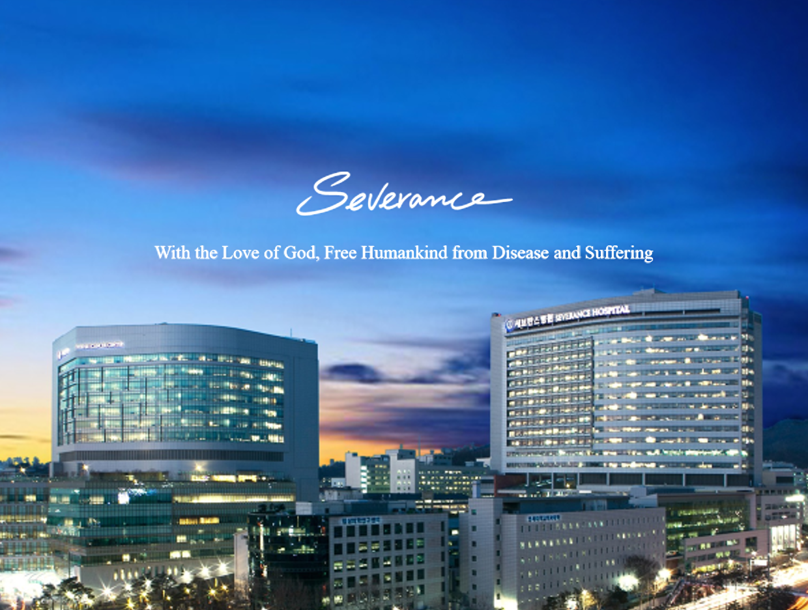
Thank You for Your Attention !

